Slide 1
EA: Smart Home Experience Project (Group Project) Individual Evaluation Report
INDIVIDUAL EVALUATION REPORT || CYRUS LAU
DDM4351
Student Name: LAU Ka Pui Student Number: 200137474
Programme/ Class: DE114102-2D1 EA Group: 3

Slide 2
Manpower Plan
Manpower planning is the process of obtaining a sufficient number of qualified people and attempting to place the right employees in the right position at the right time in order for an organization to achieve its goals. Human Resource Planning, often known as manpower planning, is a function that looks ahead.

Slide 3
Manpower Plan

Slide 4
Project Schedule (Group)
A Gantt chart is one of the most popular and practical ways of displaying activities (tasks or events) against time. A list of the activities is on the left side of the chart, and a suitable time scale is along the top. Each action is represented by a bar, whose location and length indicate the activity's start, duration, and end dates.

Slide 5
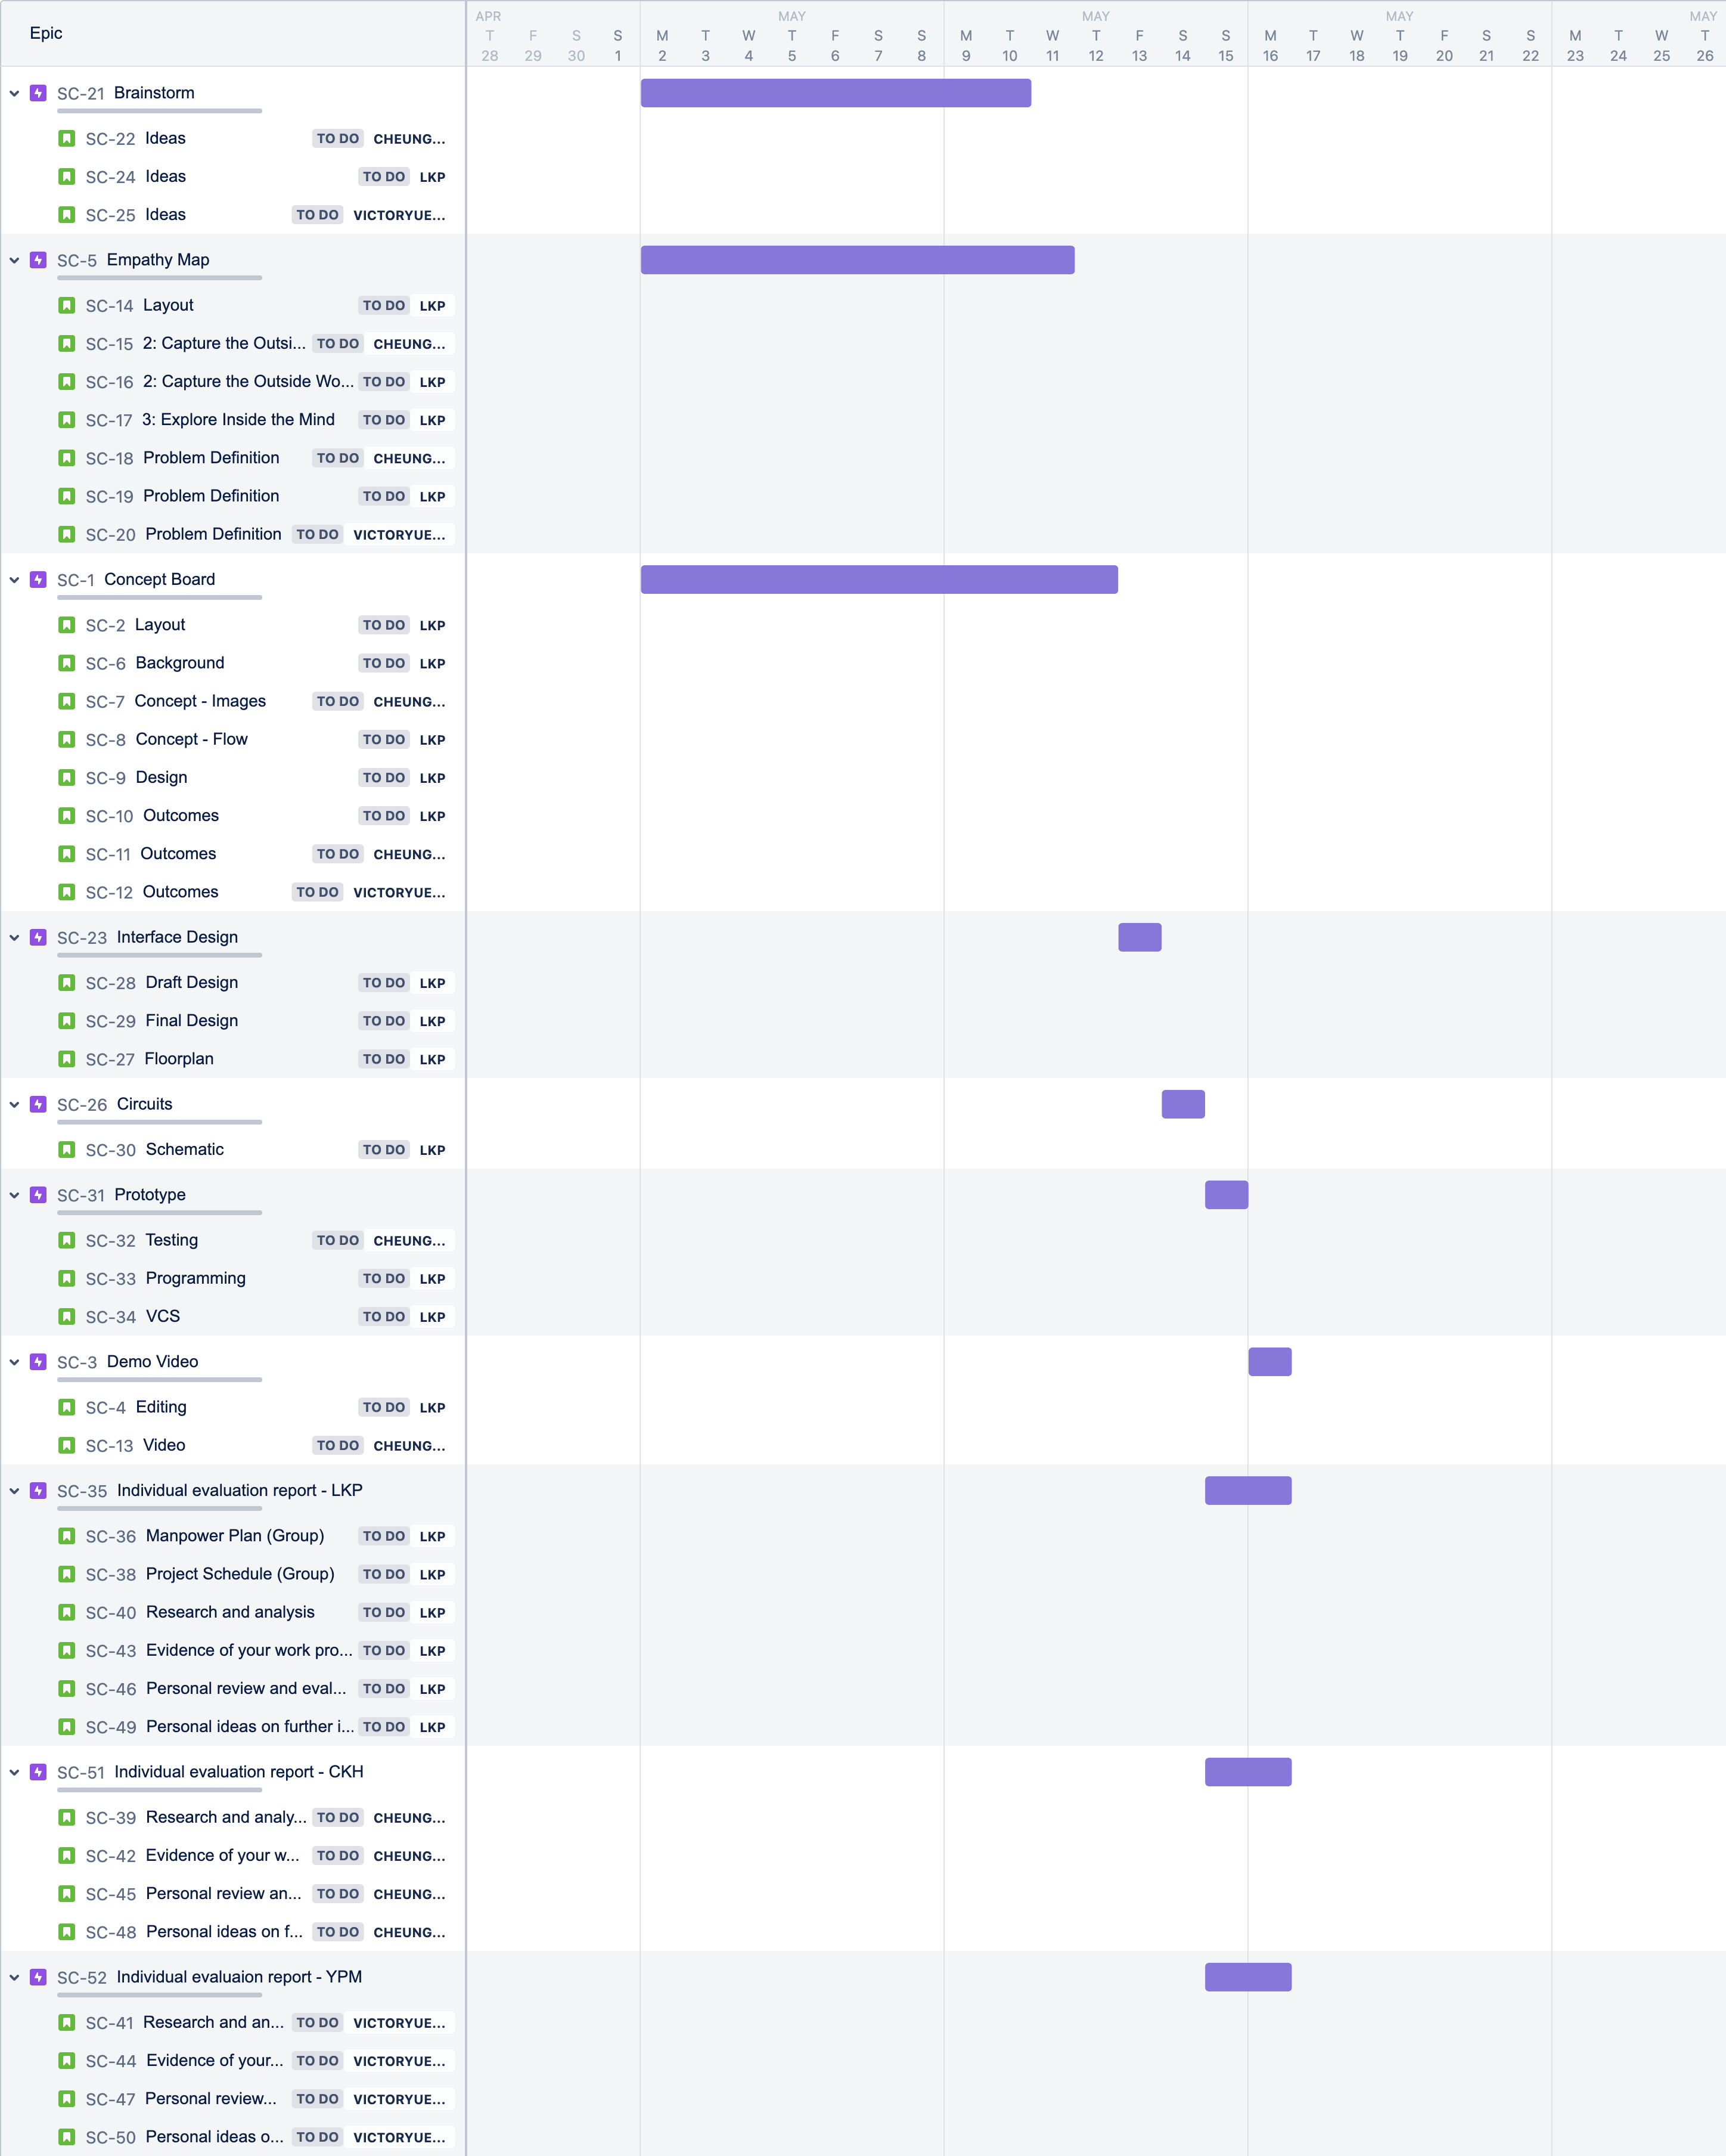
Project Schedule (Group)

Slide 6

Project Schedule (Self)
Jira Software is an agile project management solution that works with any agile methodology, including Scrum, Kanban, and your own. You can plan, track, and manage all of your agile software development projects from a single solution, which includes agile boards, backlogs, roadmaps, reports, integrations, and add-ons.

Slide 7
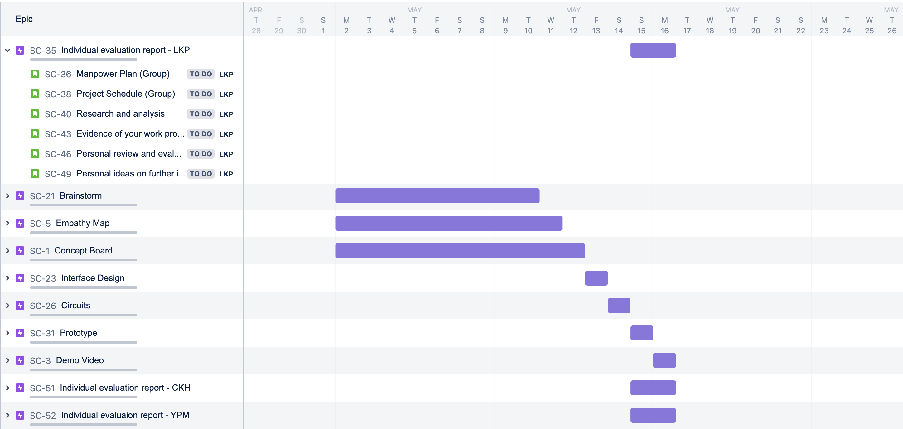
Project Schedule (Self)

Slide 8
_
Research and Analysis

Slide 9
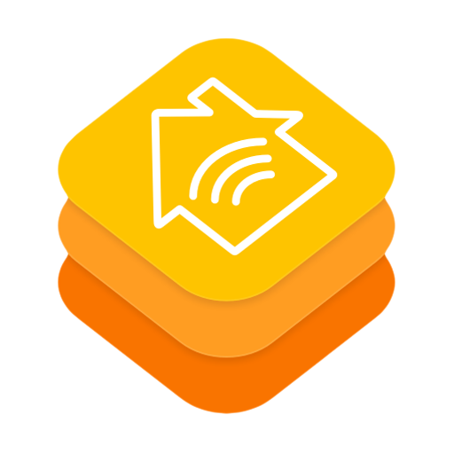
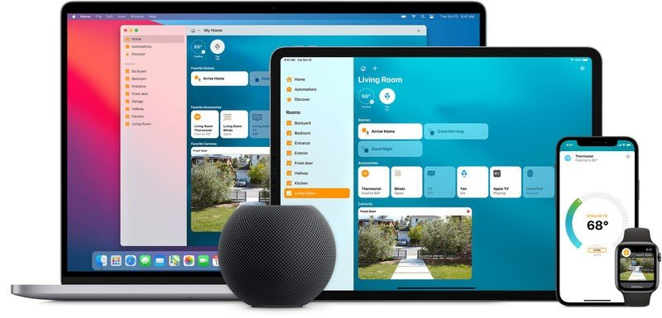
HomeKit
Software
HomeKit is an iOS/iPadOS software framework that allows users to configure, communicate with, and operate smart-home gadgets using Apple devices. It gives users the ability to discover and setup such devices automatically.
We use it as part of a bridge between sensors and the Home app

Slide 10
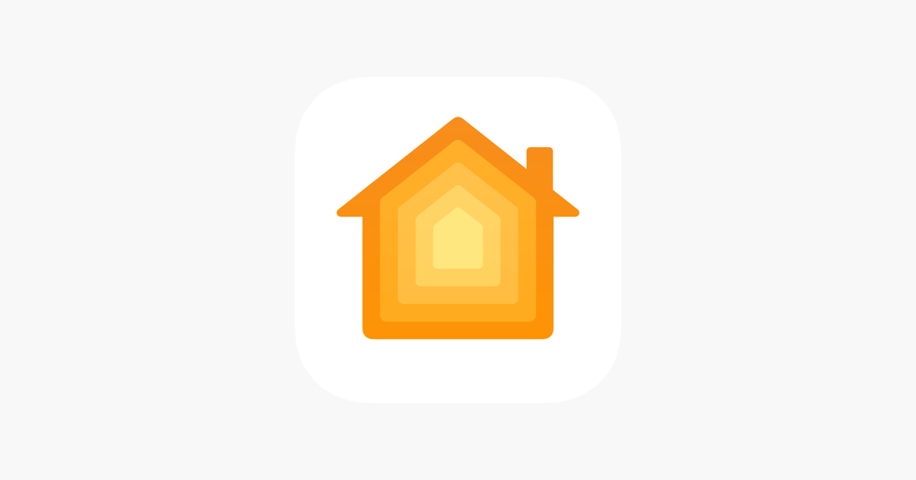
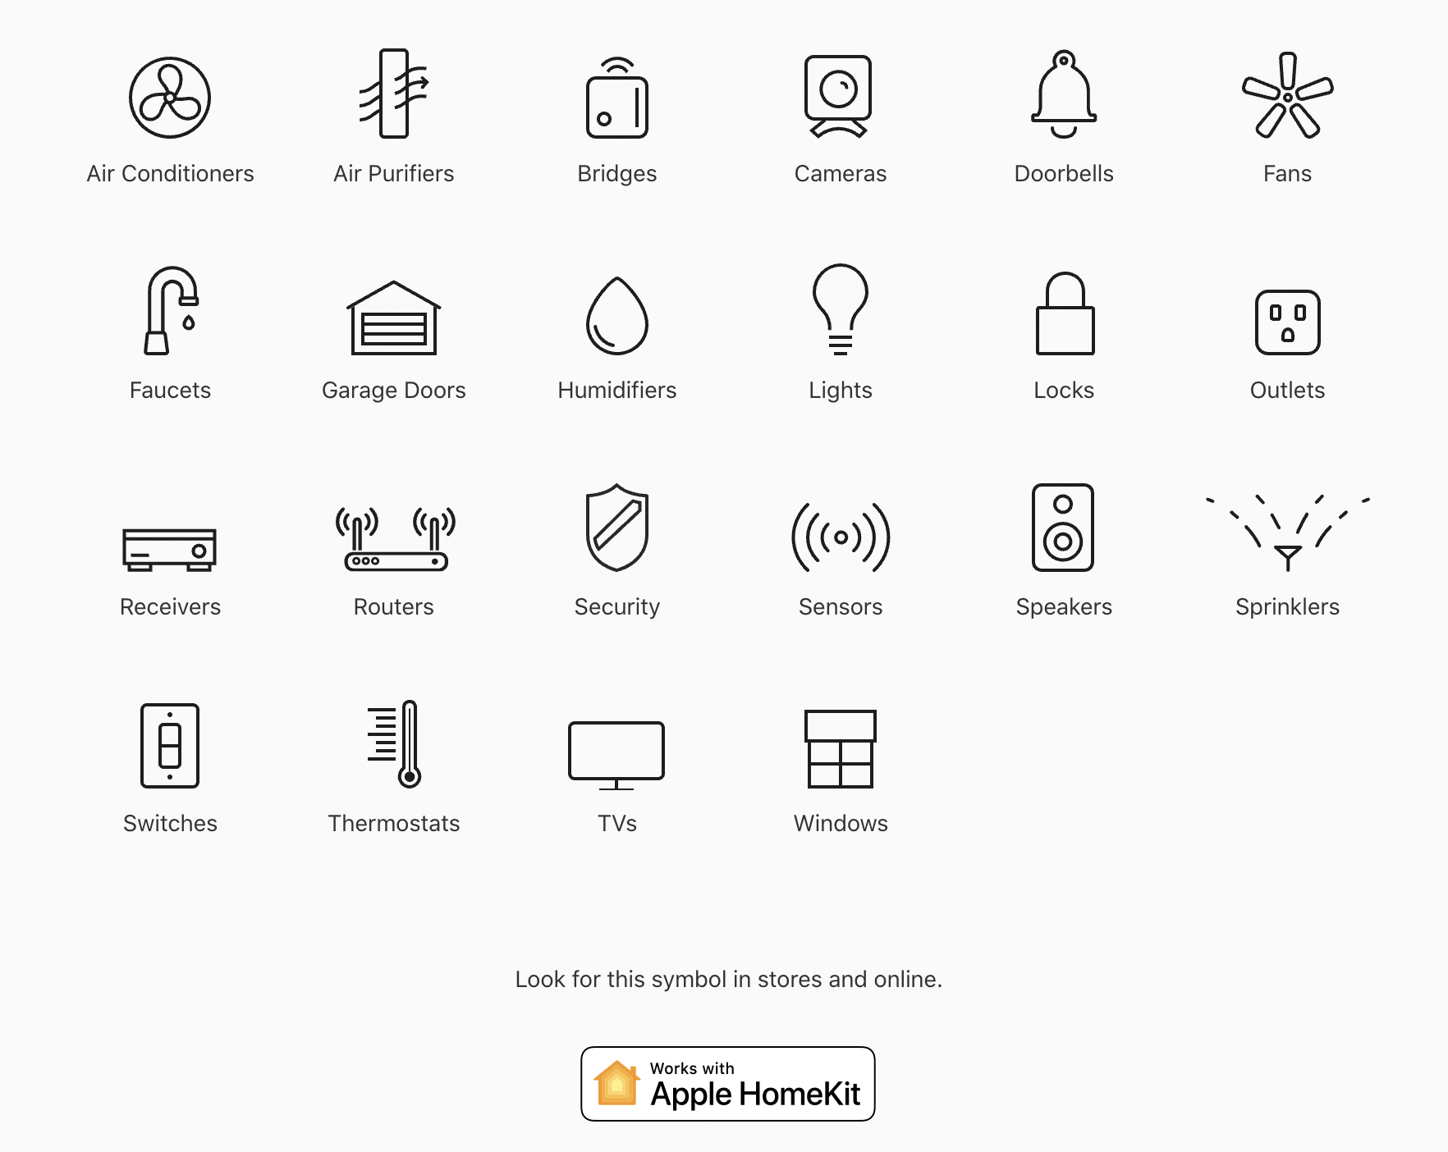
Home
Application
You can quickly and securely control your HomeKit accessories from all of your Apple devices with the Home app. Turn off the lights, check who's at the door, alter the temperature in your living room, crank up the music, and so much more.
It is the user interface for HomeKit and provides a way for the user to control and observe sensors

Slide 11

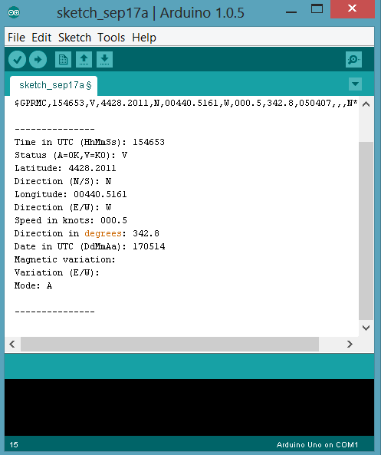
Arduino
Platform
Arduino is a corporation, initiative, and user community that designs and manufactures single-board microcontrollers and microcontroller kits for making digital devices using open-source hardware and software.
We use it to compile HomeKit and the sensor-to-board connection program

Slide 12
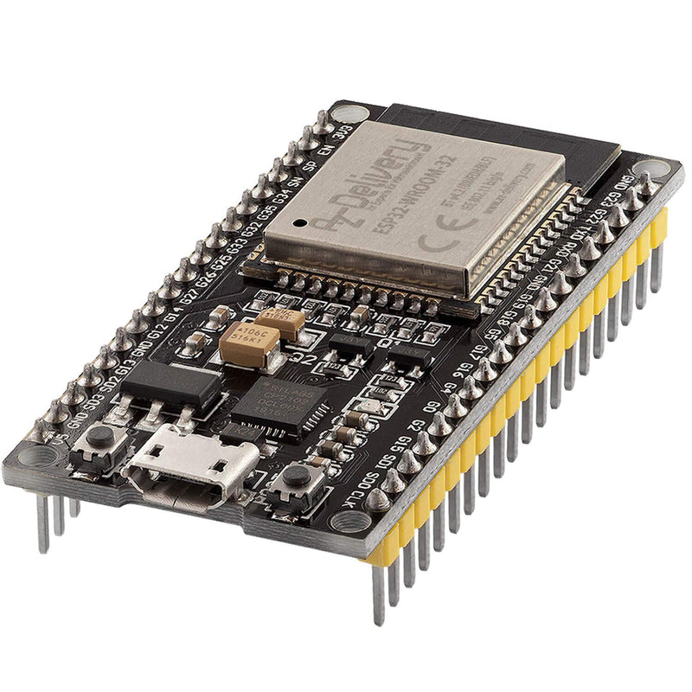
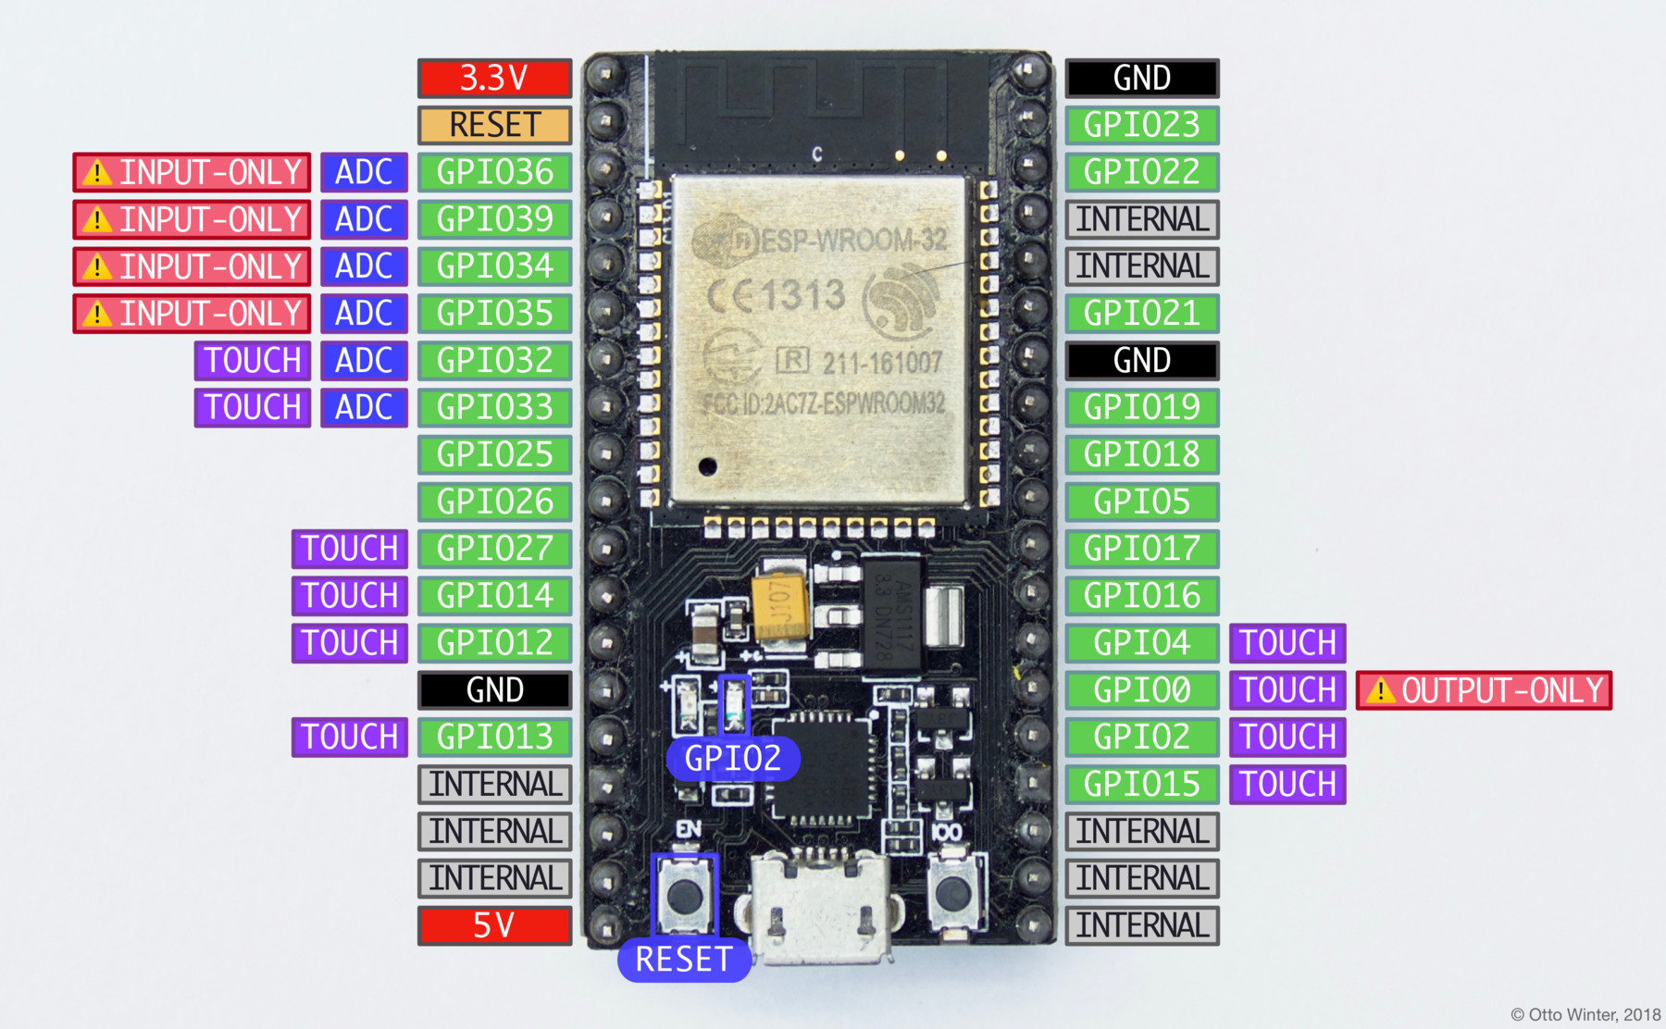
NodeMCU ESP32
Motherboard
The NodeMCU ESP32 board (in some cases also known as ESP32-DevkitC) is fully supported by ESPHome. Simply select ESP32 when the ESPHome wizard asks you for your platform and nodemcu-32s as the board type.
We compile the program to the motherboard to make a smart home office project

Slide 13
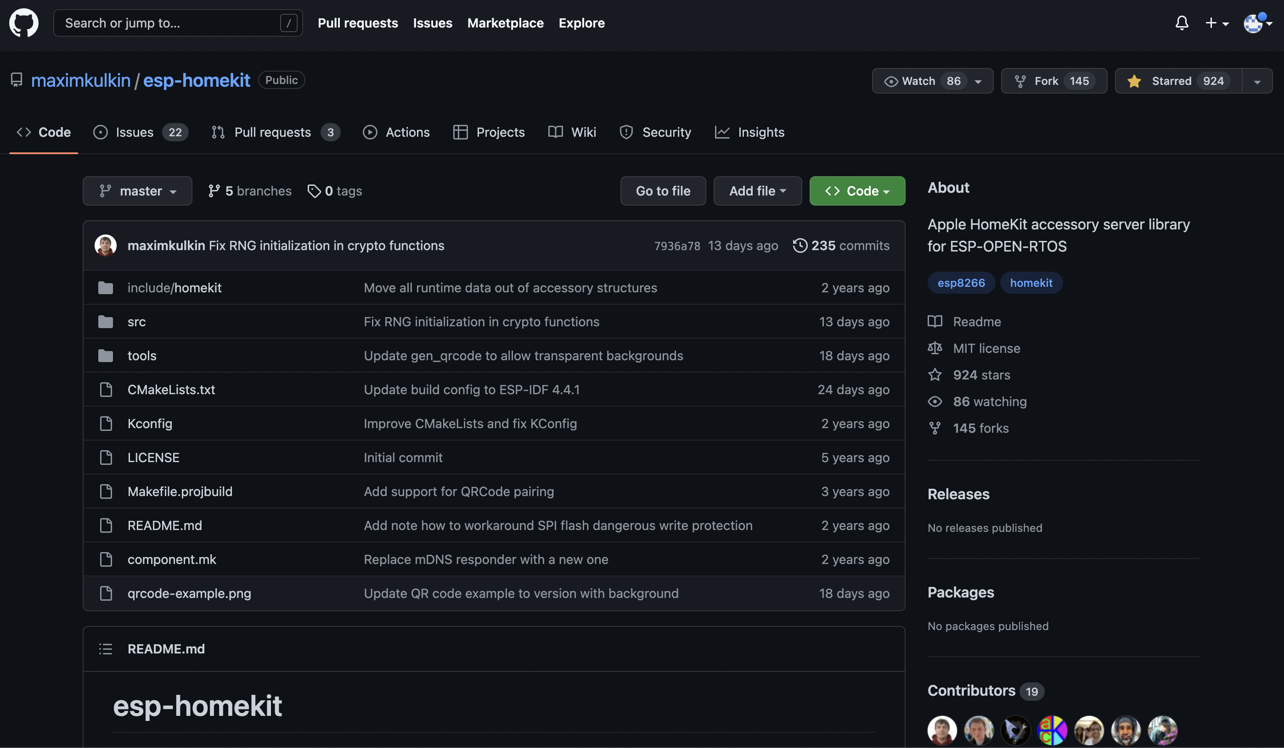
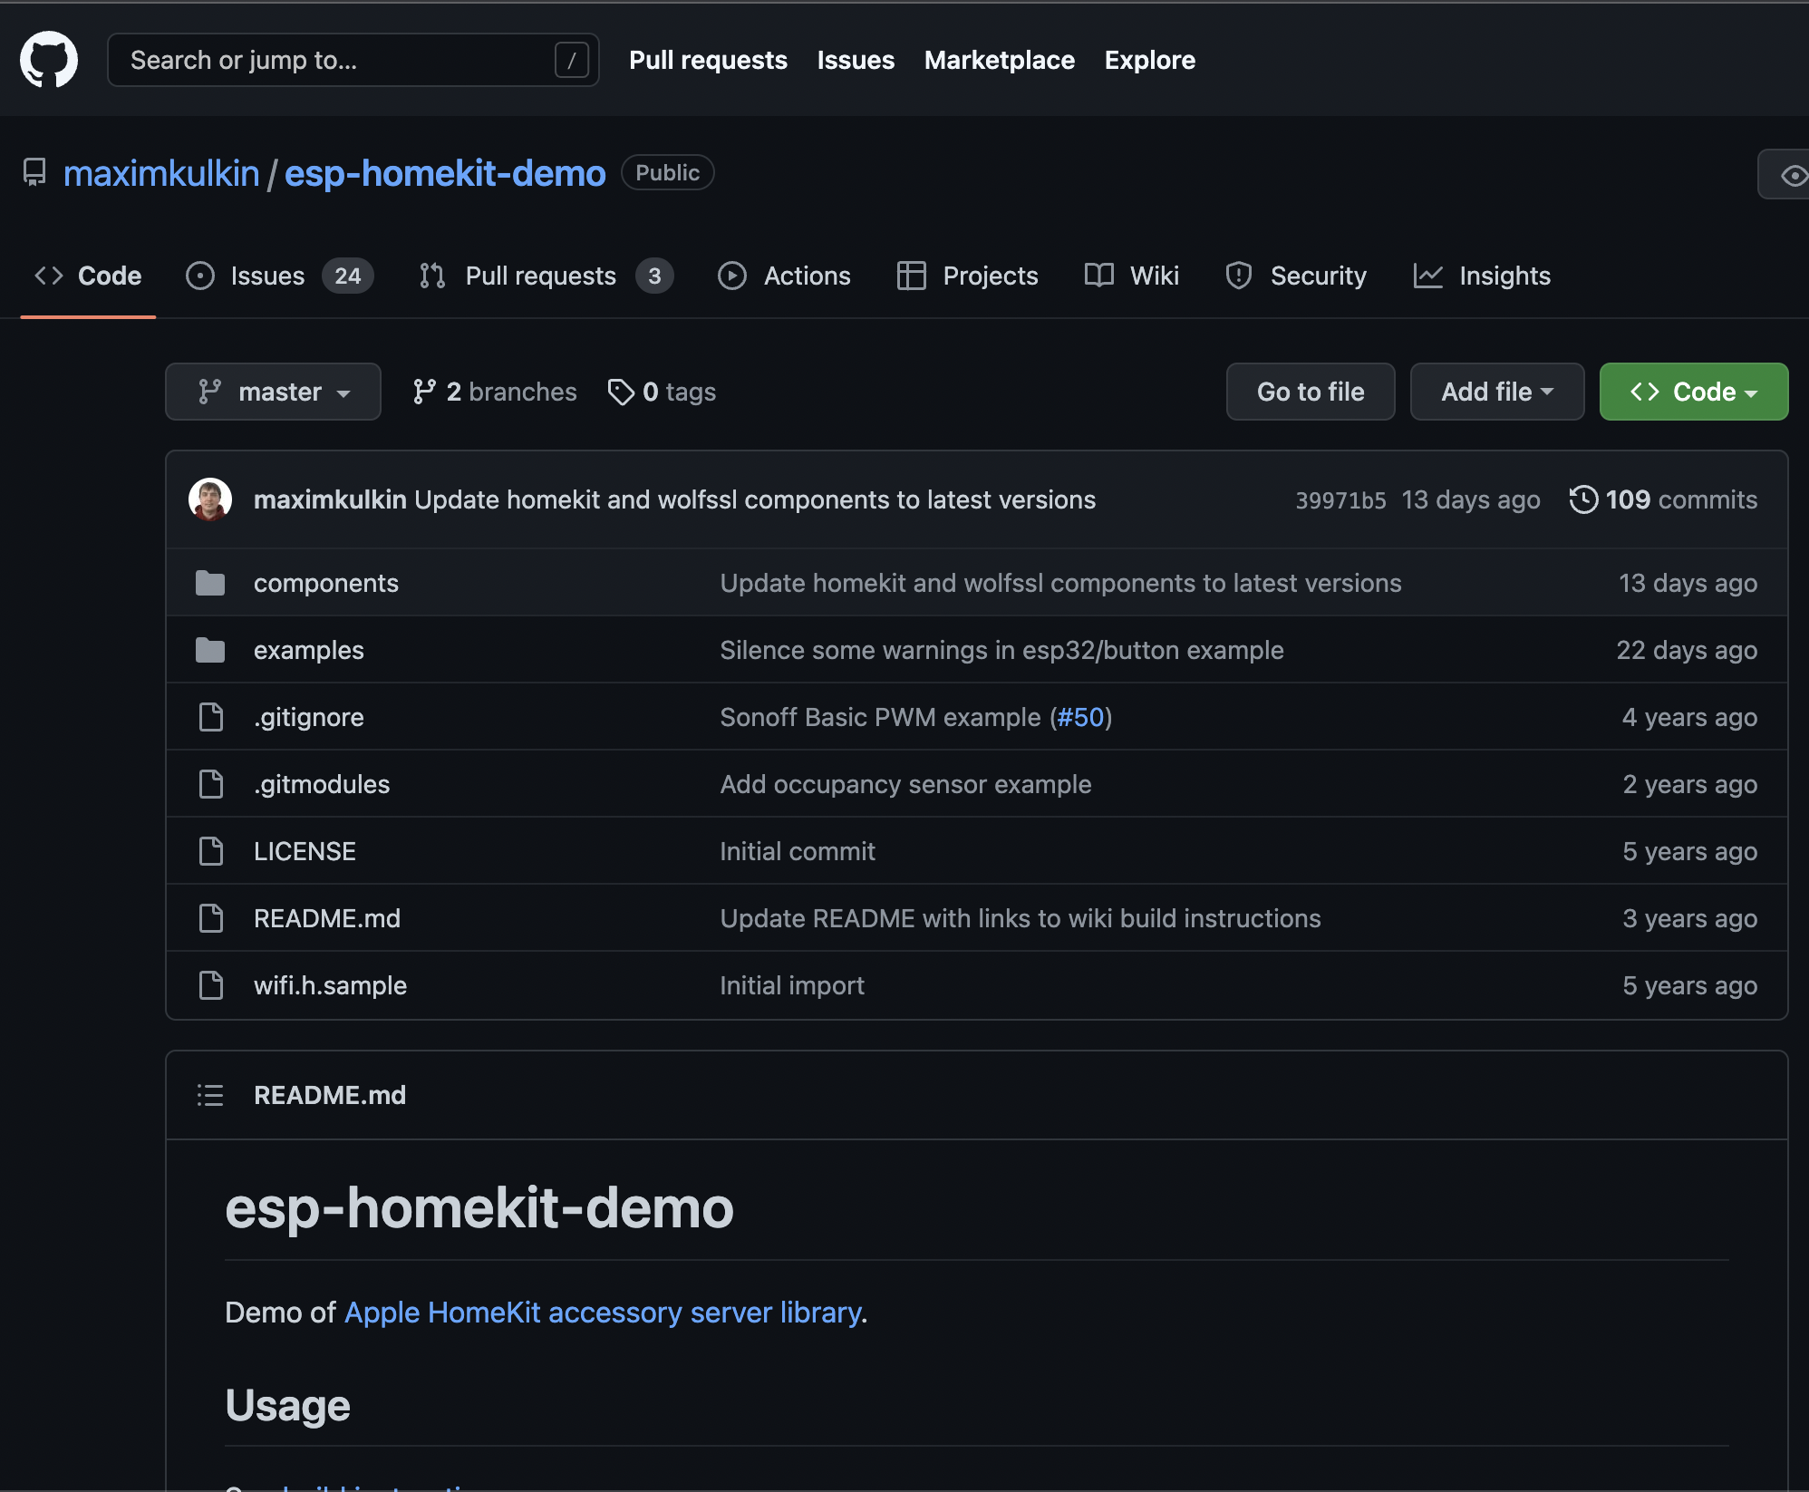
esp-homekit
For ESP32/ESP8266
Apple HomeKit accessory server library for ESP-OPEN-RTOS. Project to add native Apple HomeKit support to any device with an ESP32/ESP8266 chip
We use this GitHub project to implement our HomeKit functionality on the ESP32 board

Slide 14
Evidence of my work produced for the project

Slide 15
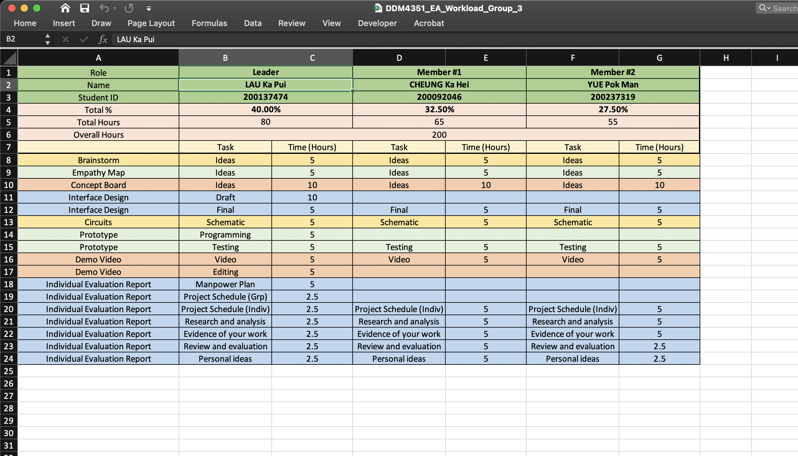
Evidence of my work produced for the project
01 Manpower Plan
I am working on a manpower plan for all my teammates including me

Slide 16
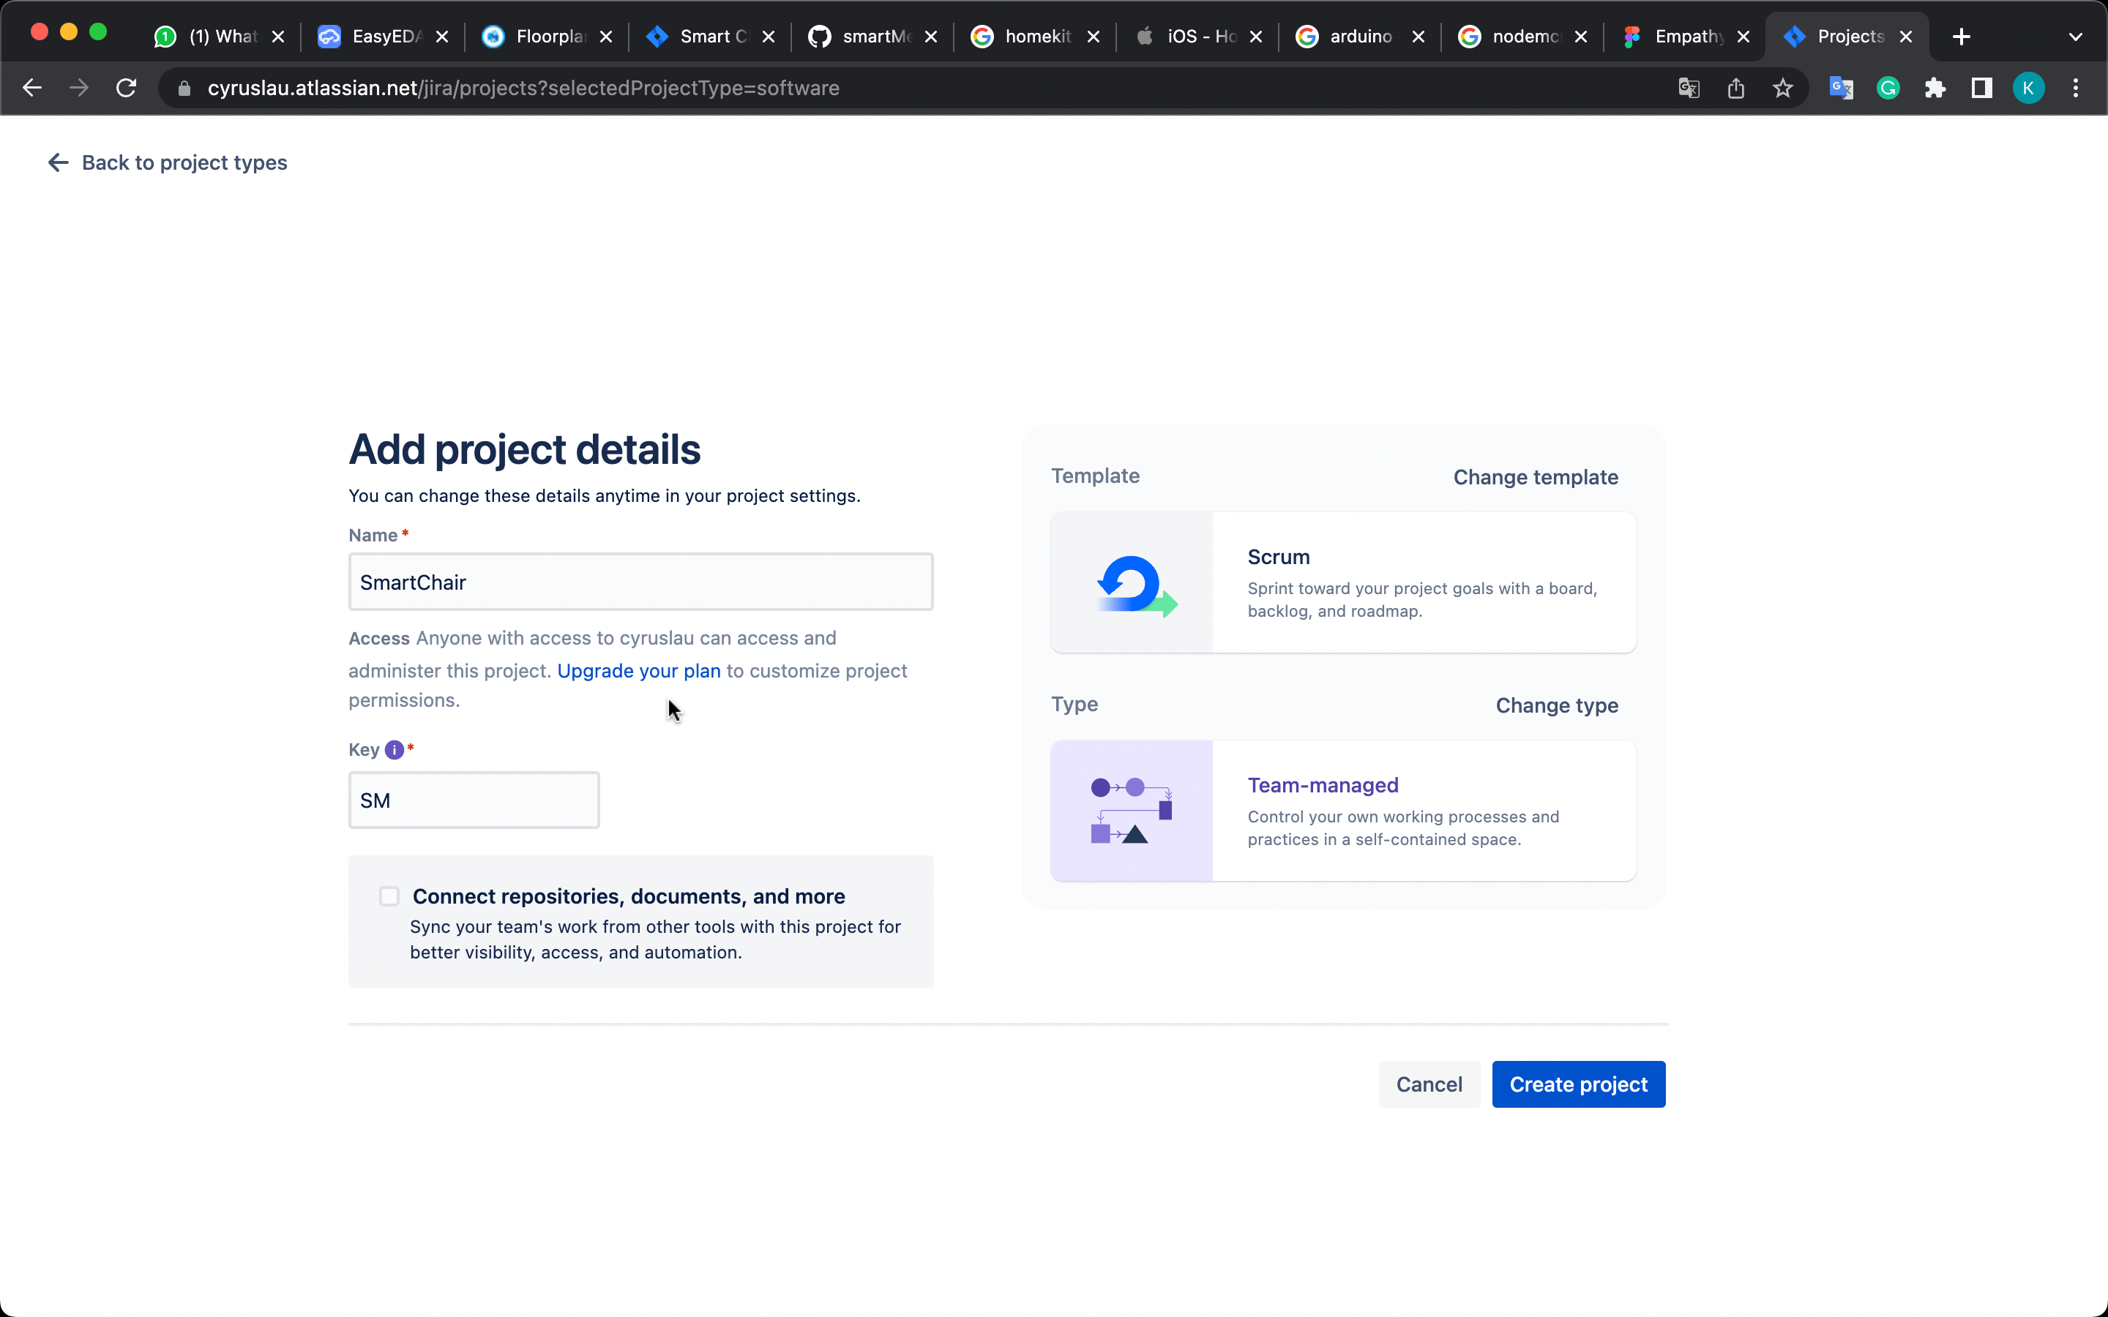
Evidence of my work produced for the project
02 Gantt Chart
I created a Jira project for project management and invited my teammates to the Jira project and used it to export a Gantt chart.

Slide 17
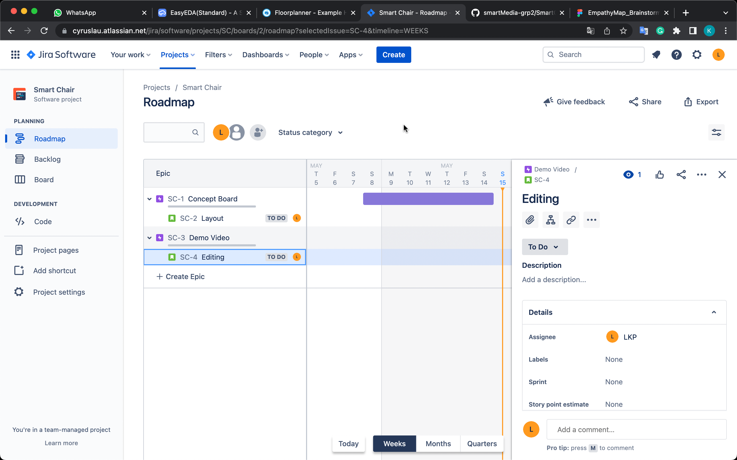
Evidence of my work produced for the project
02 Gantt Chart
I am making a Jira roadmap, the roadmap can be exported as a Gantt chart by Jira software (A SaaS for SCM)

Slide 18
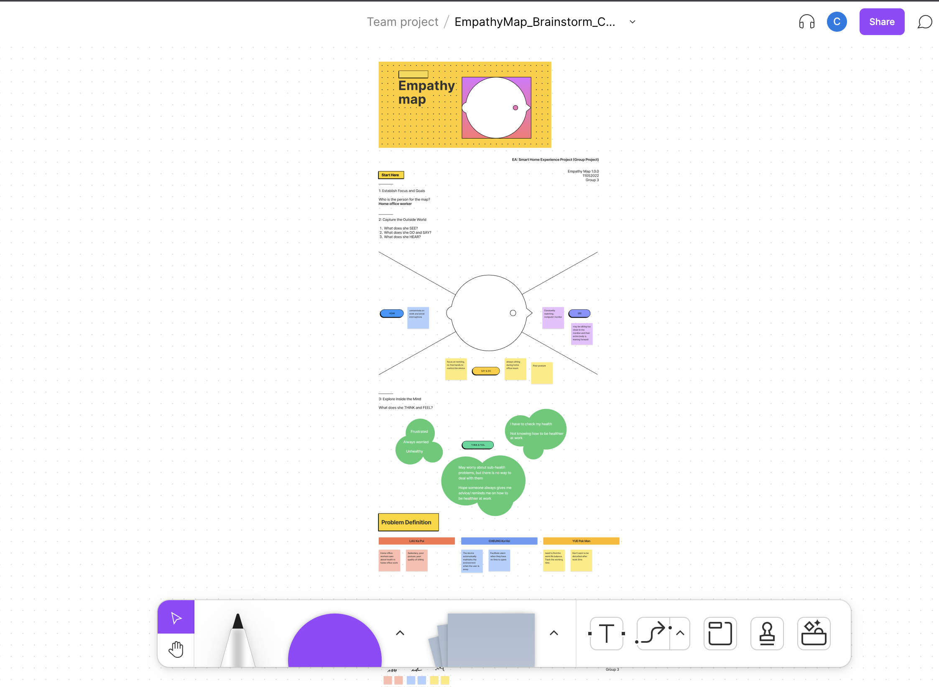
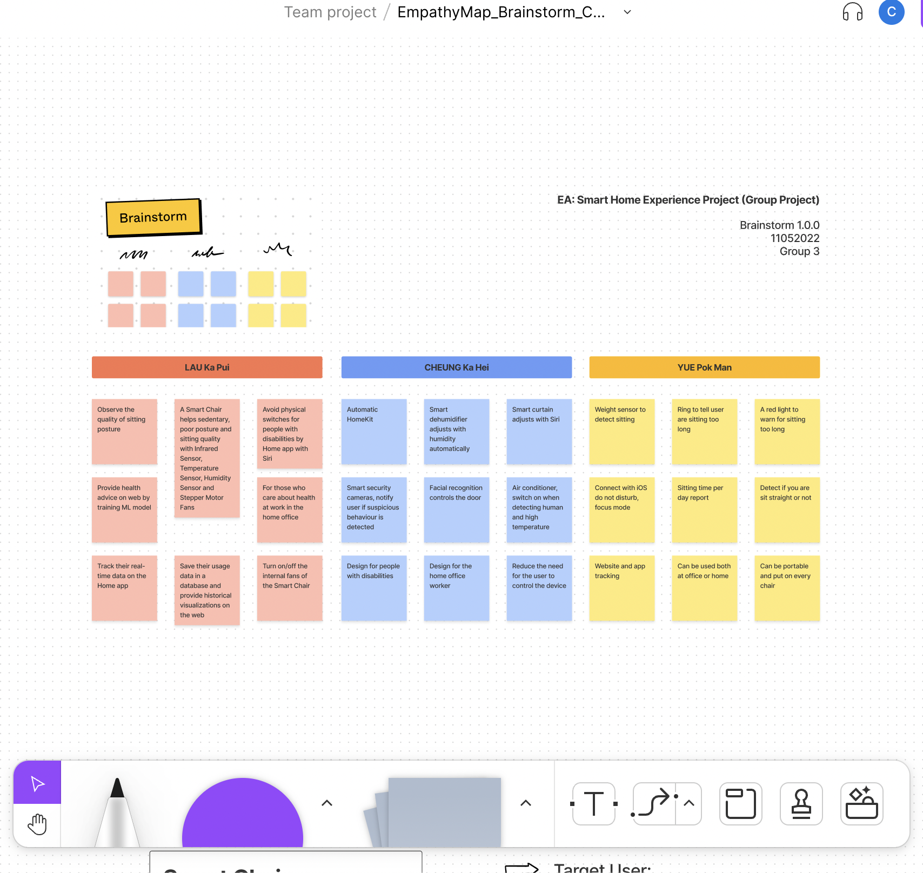
Evidence of my work produced for the project
03 Art Works
I have made an empathy map and brainstorming.

Slide 19
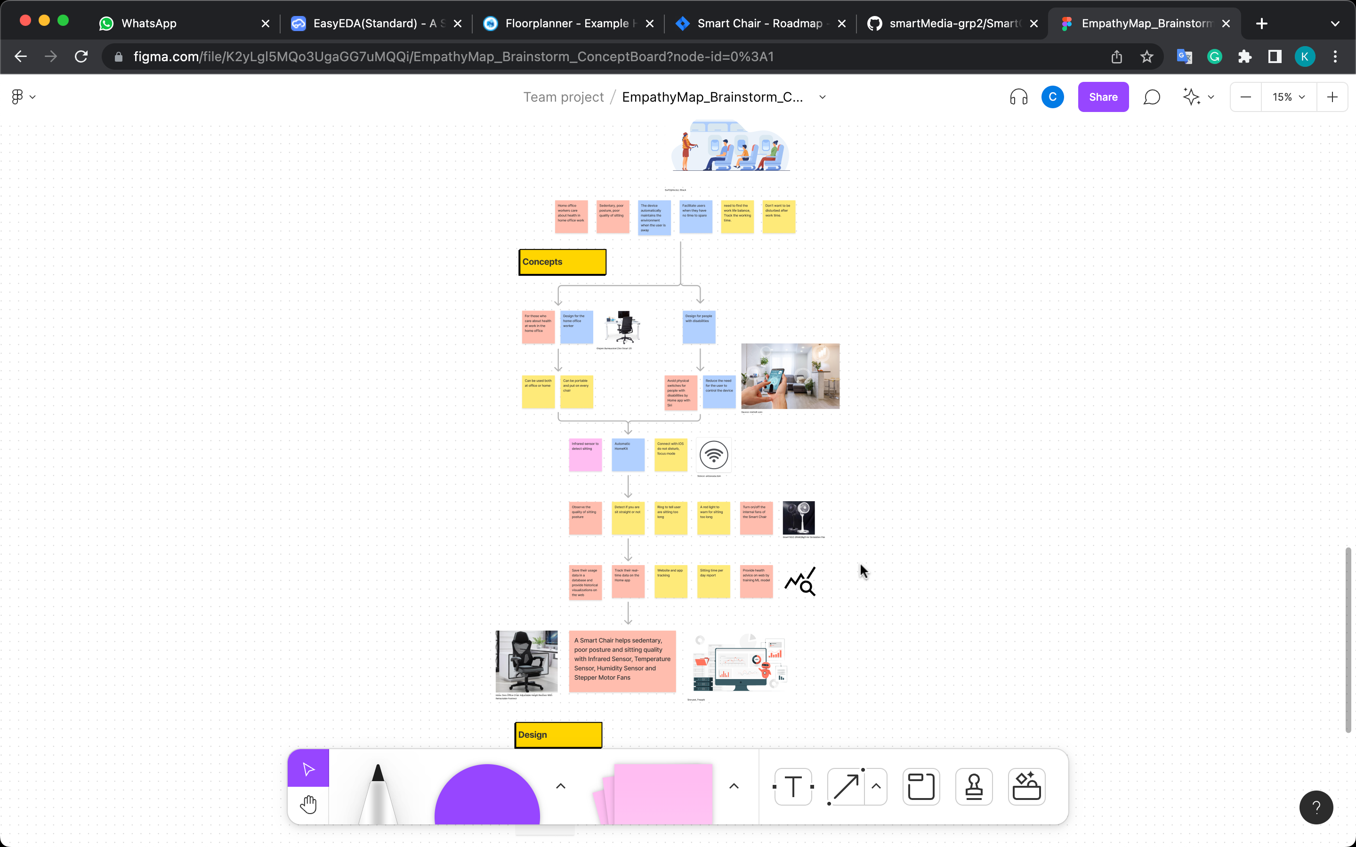
Evidence of my work produced for the project
03 Art Works
I am now working on a concept board by using Figma (A SaaS for design and prototype)

Slide 20
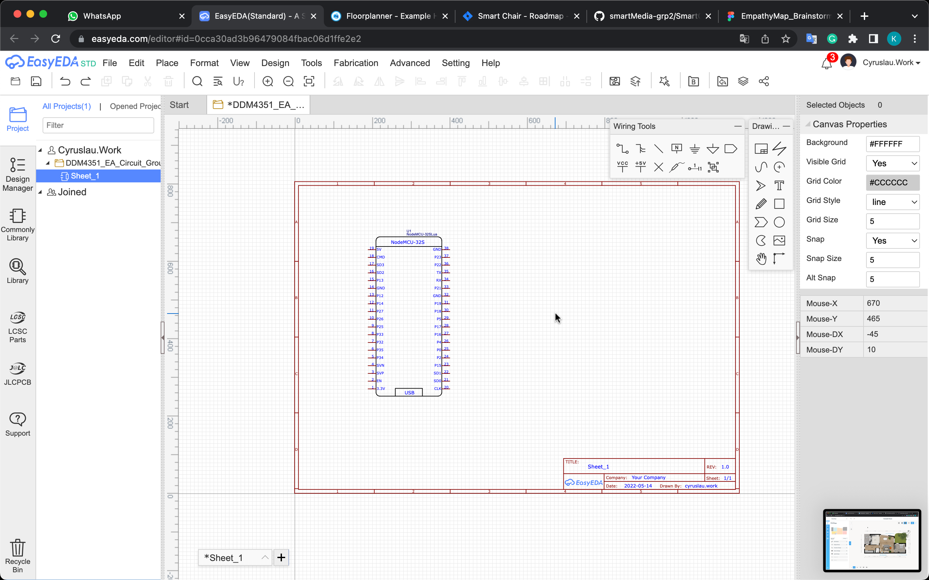
Evidence of my work produced for the project
03 Art Works
I am using EasyEDA (A SaaS) to create a circuit schematic

Slide 21
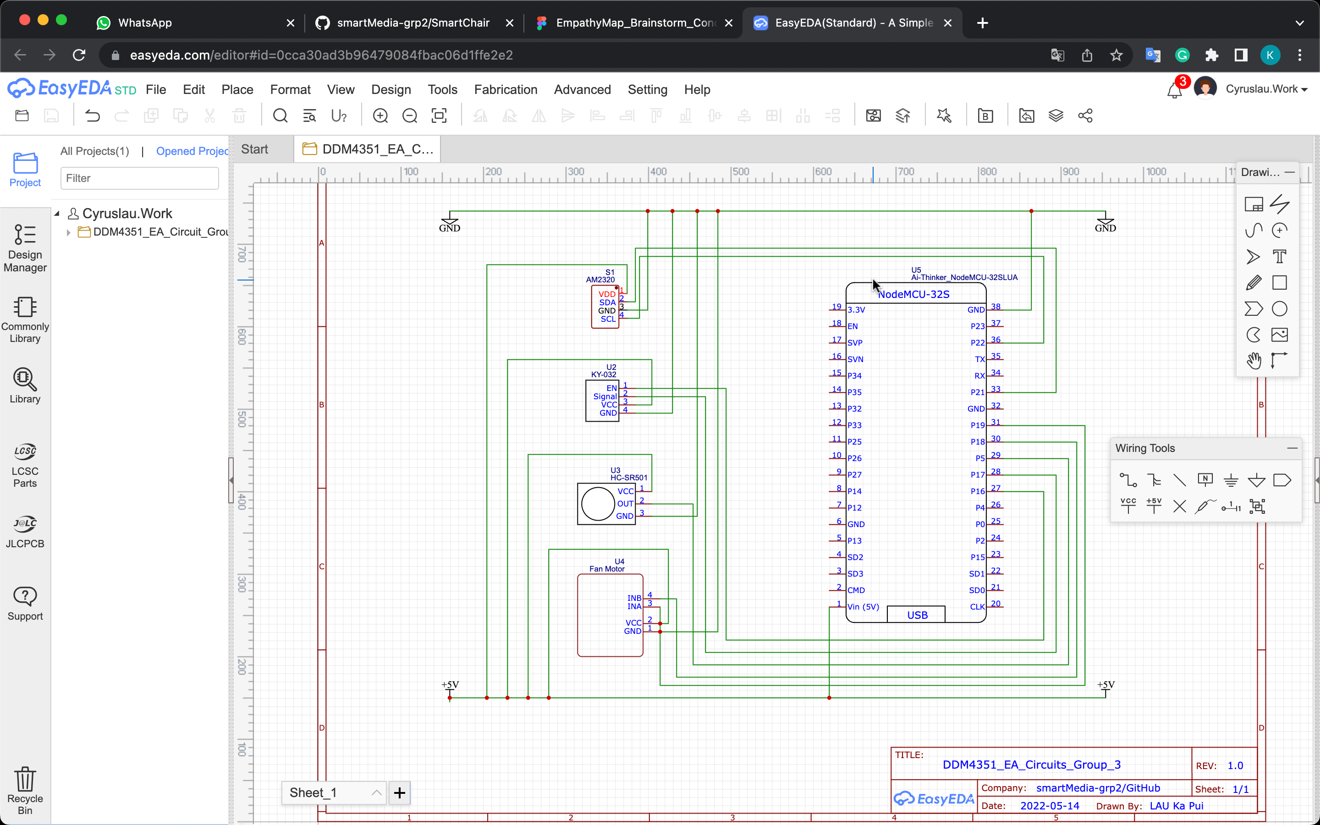
Evidence of my work produced for the project
03 Art Works

Slide 22
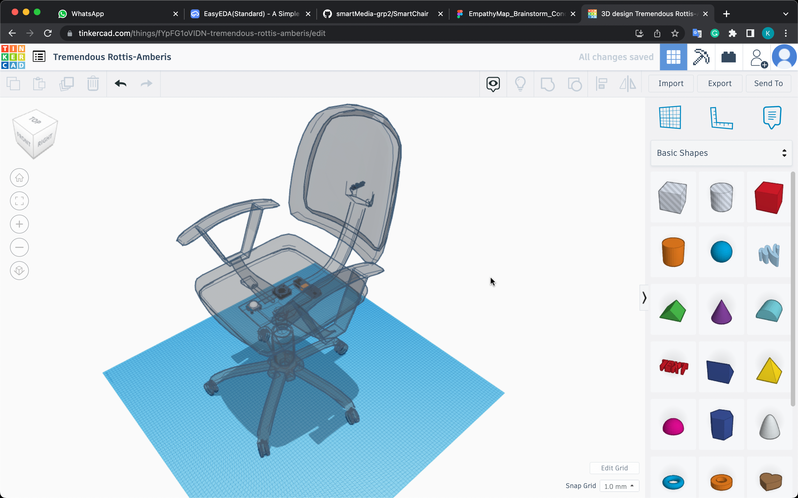
Evidence of my work produced for the project
03 Art Works
I am using Tinkercad to create a 3D model for the sensor and board installation guide

Slide 23
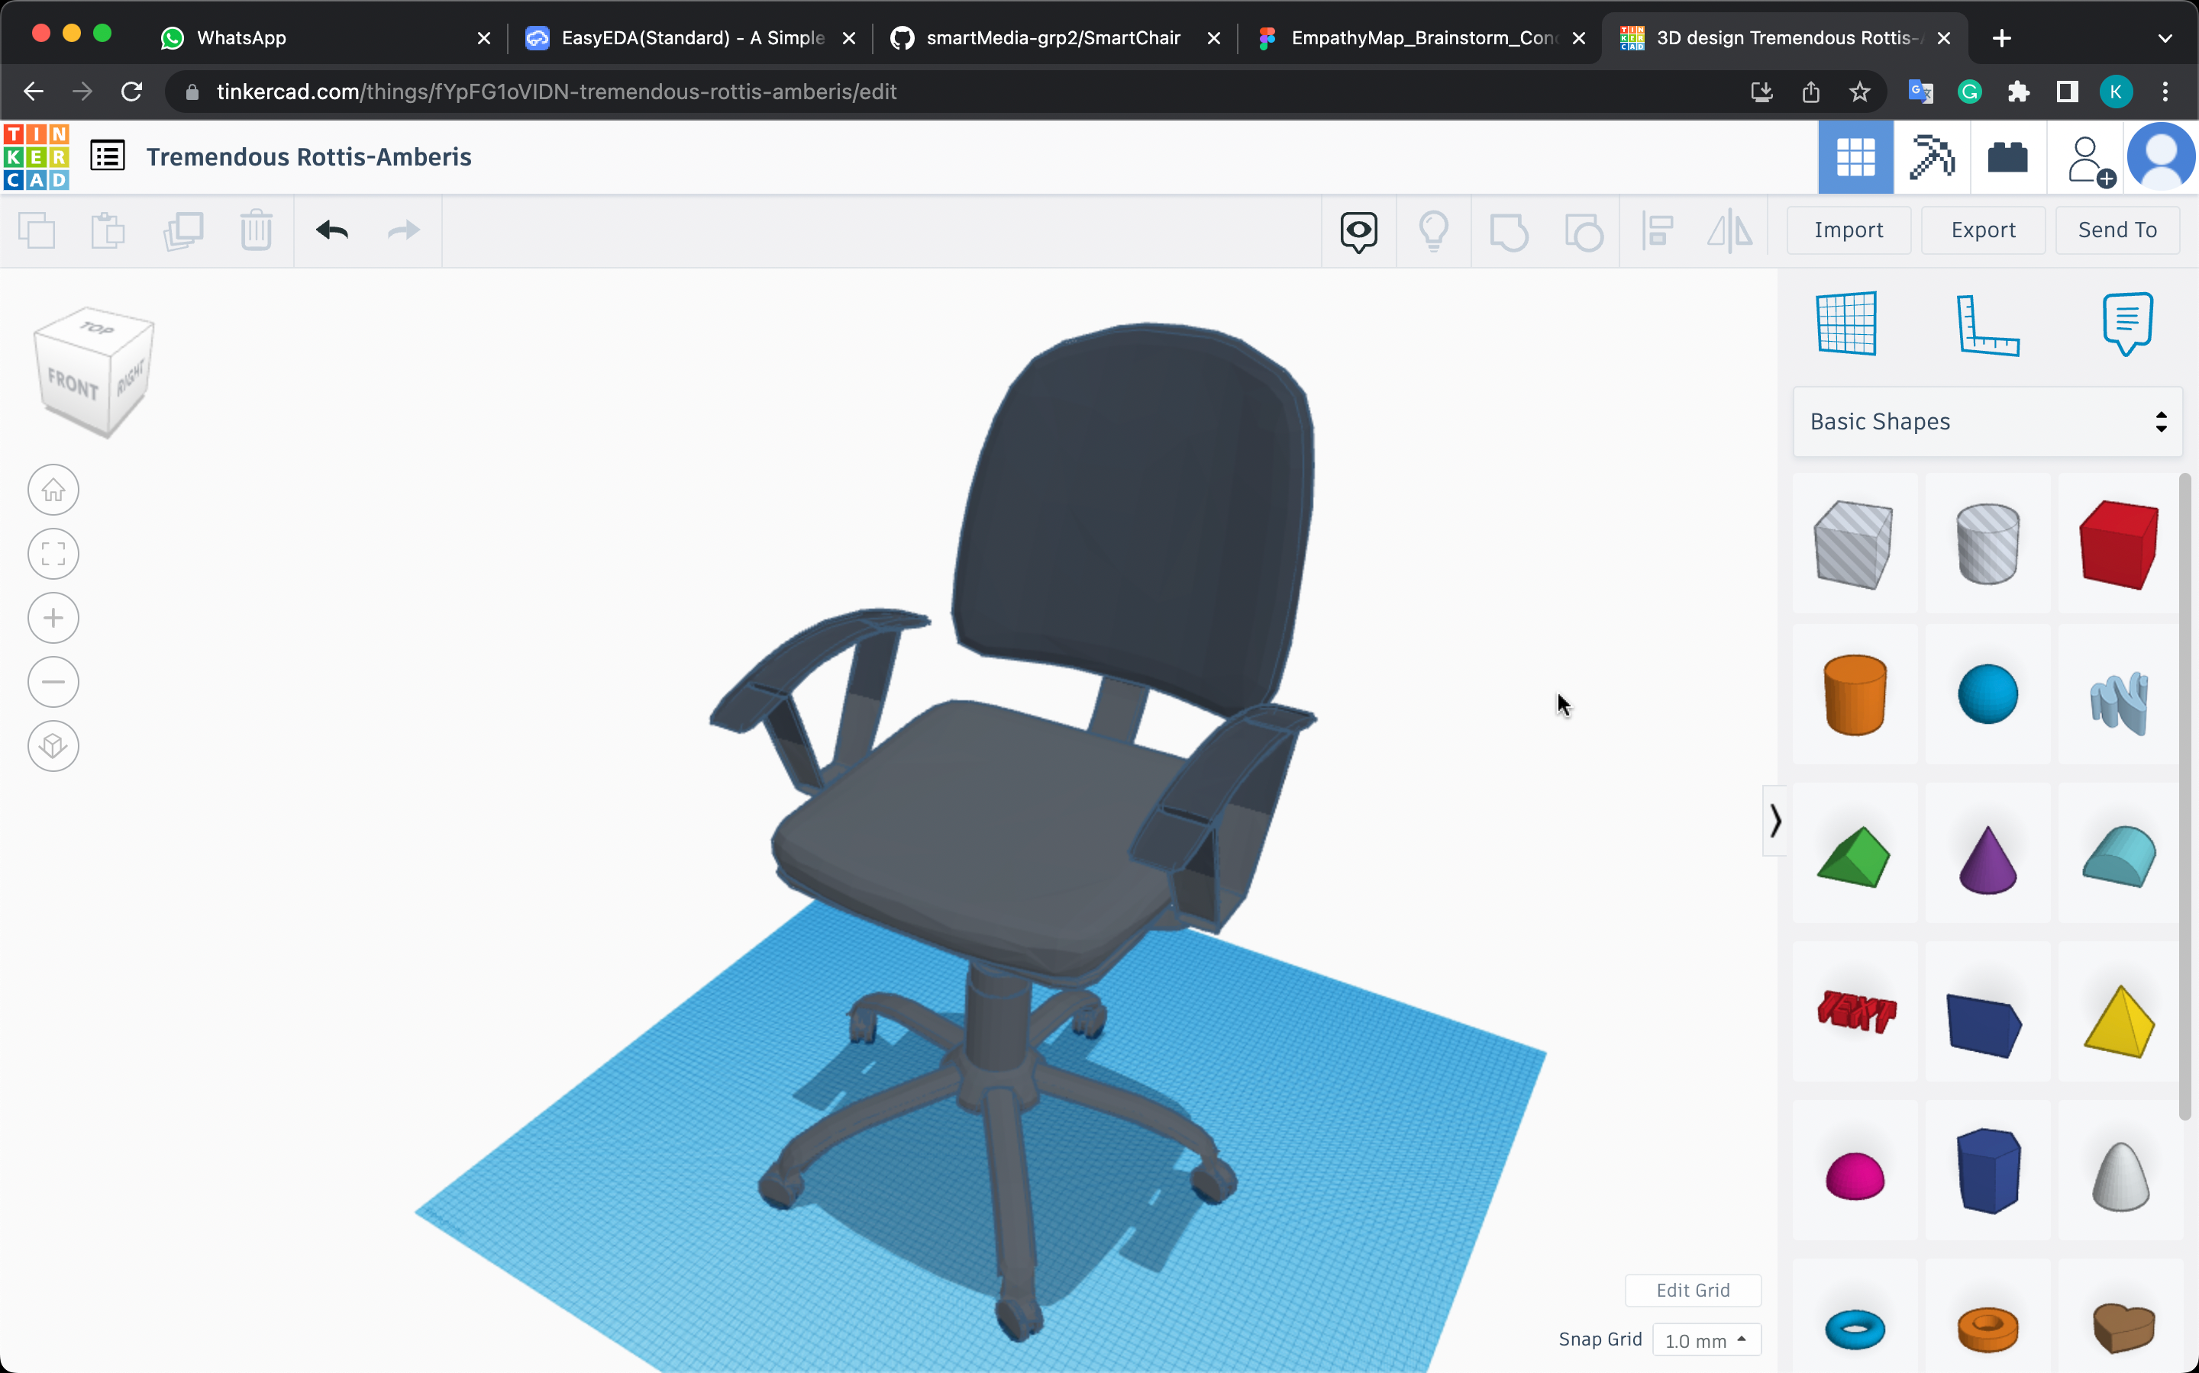
Evidence of my work produced for the project
03 Art Works
Final Design

Slide 24
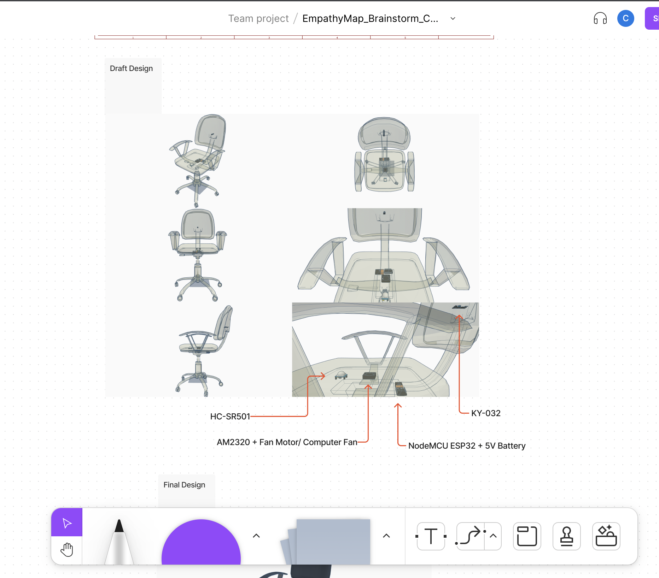
Evidence of my work produced for the project
03 Art Works
Paste on Concept Board

Slide 25
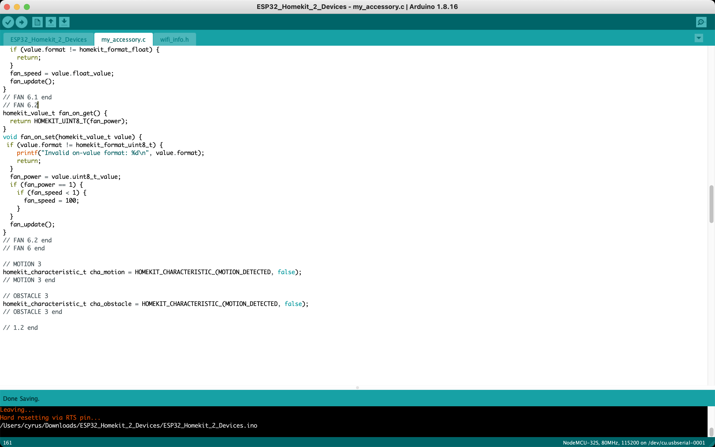
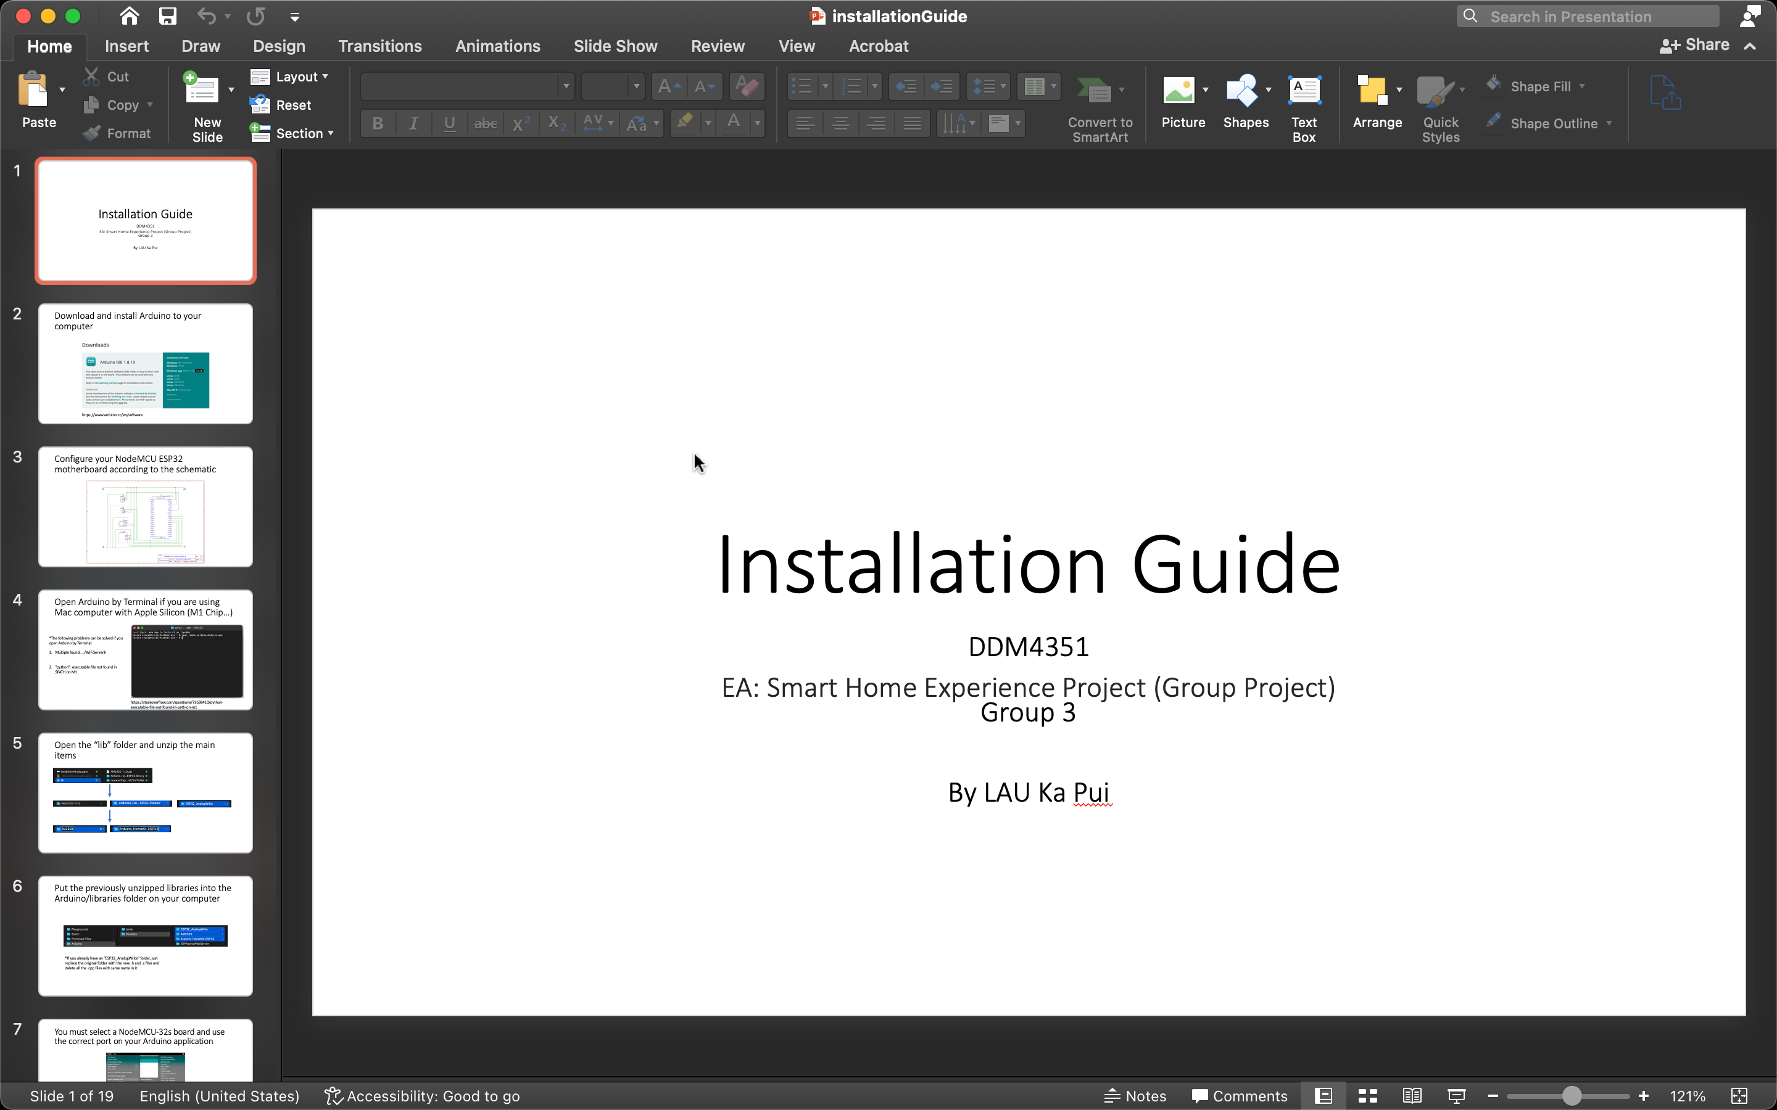
Evidence of my work produced for the project
04 Apps

Slide 26
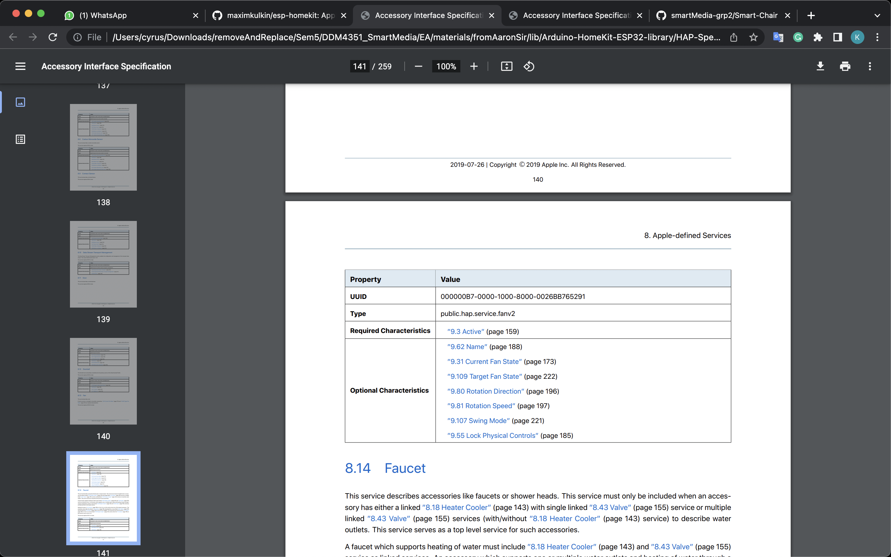
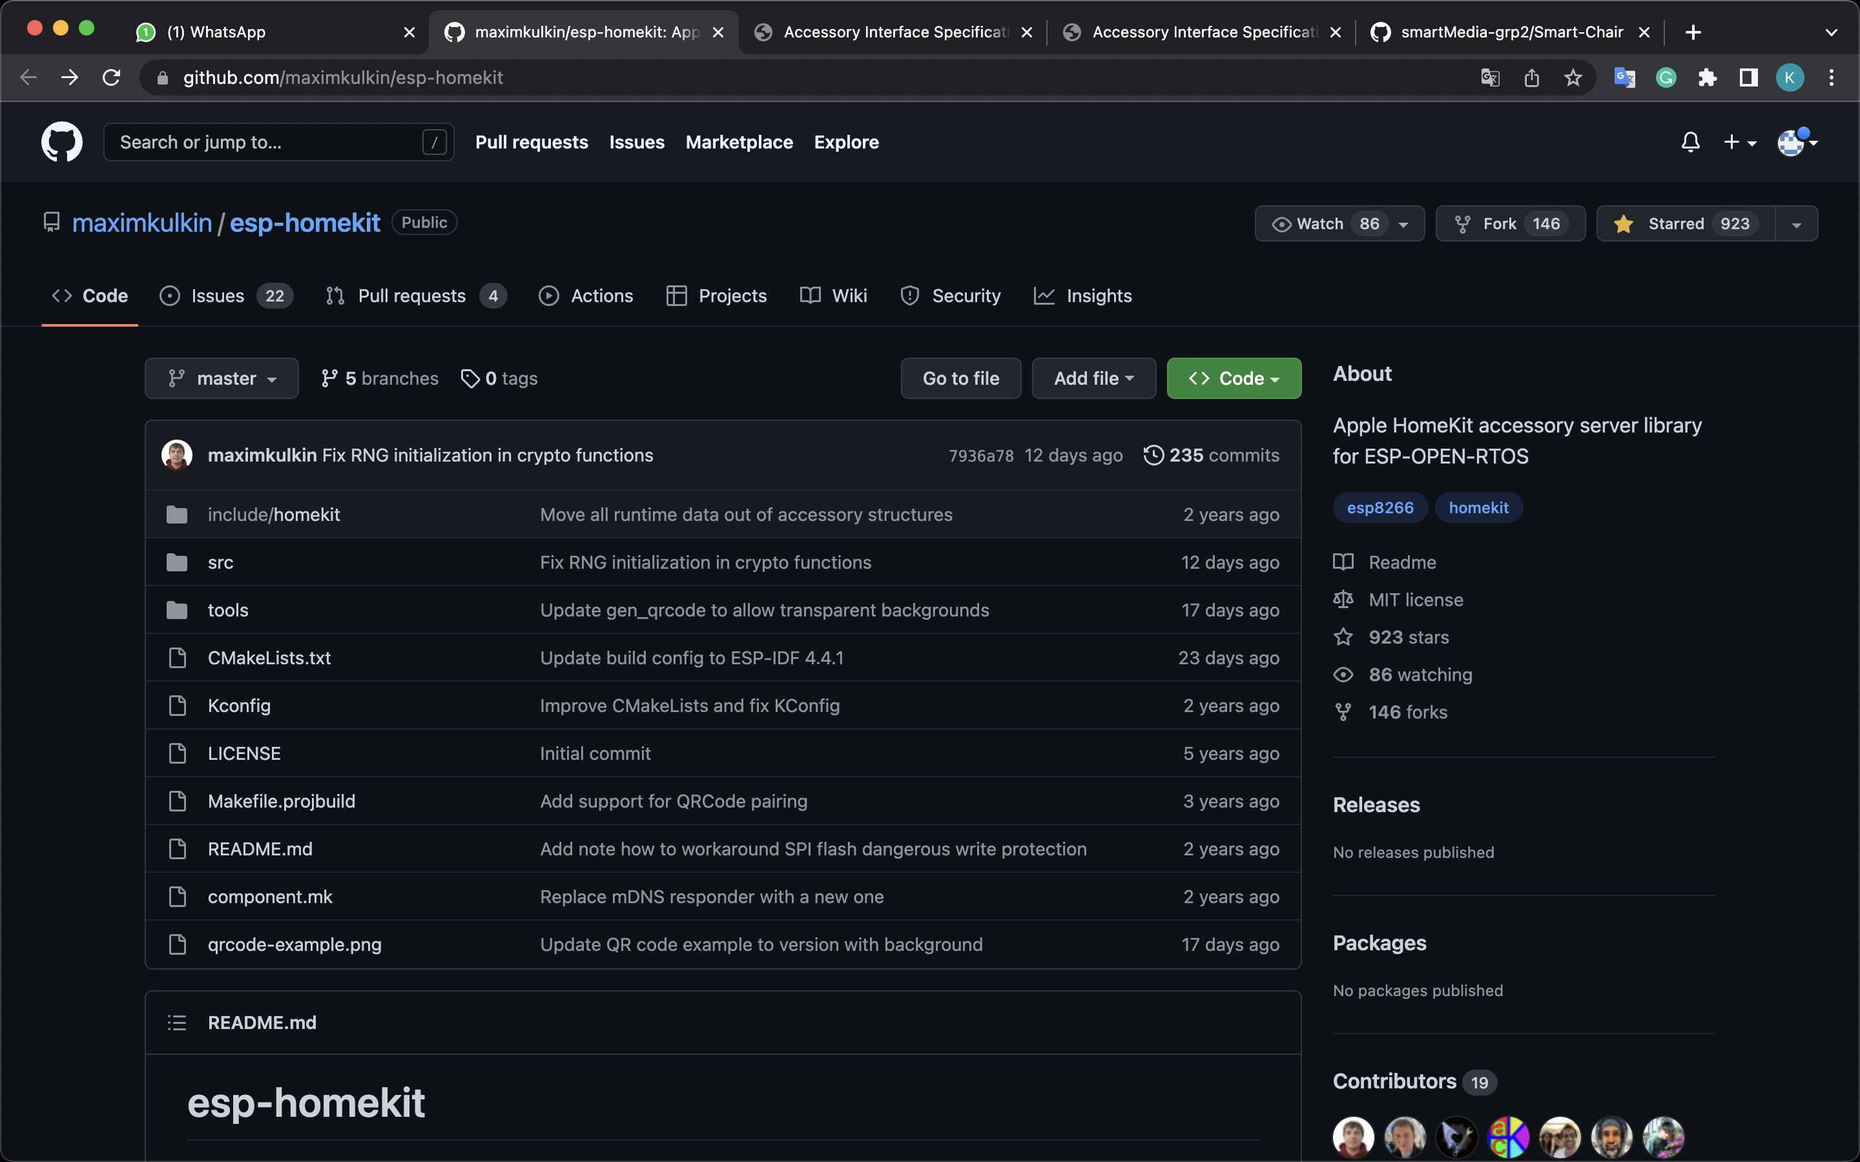
Evidence of my work produced for the project
04 Apps
Use Apple HAP documentation and other examples on GitHub

Slide 27
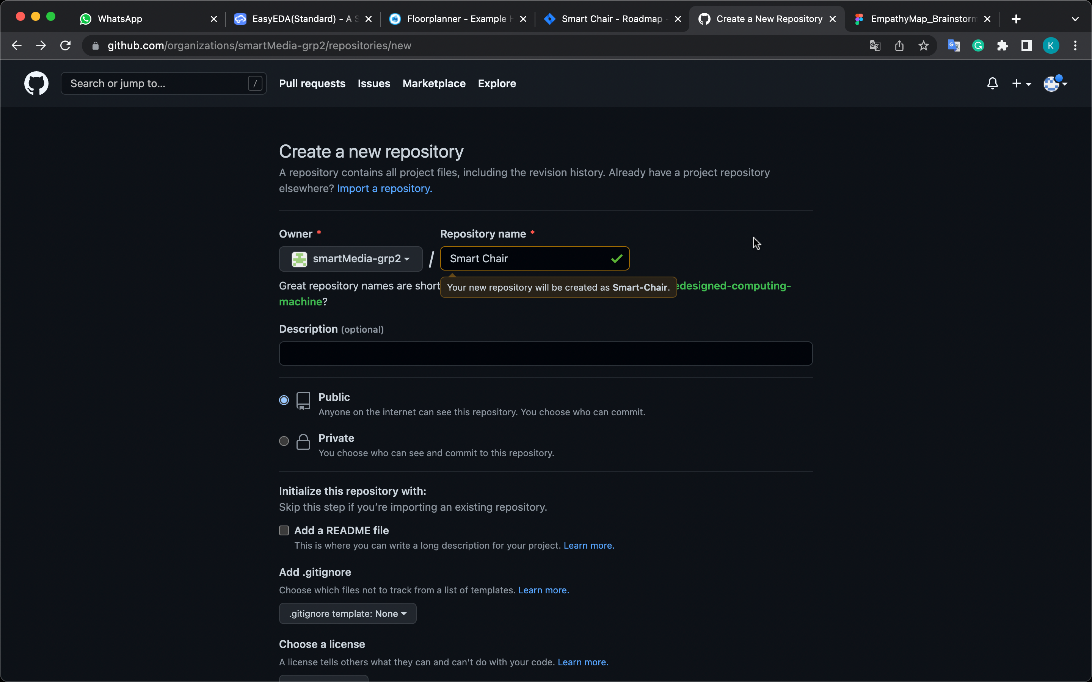
Evidence of my work produced for the project
05 VCS
I am creating a GitHub repository for our existing organisation (smartMedia-grp2, but now is group 3 in EA)

Slide 28
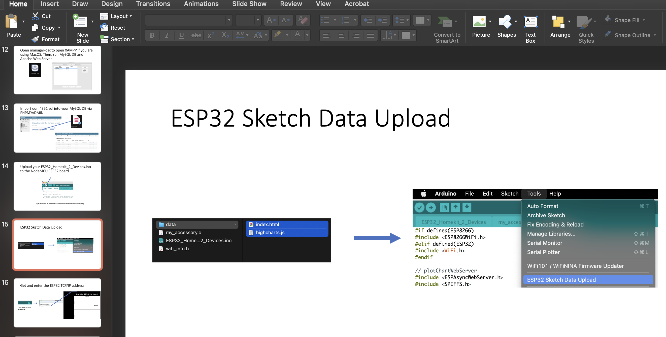
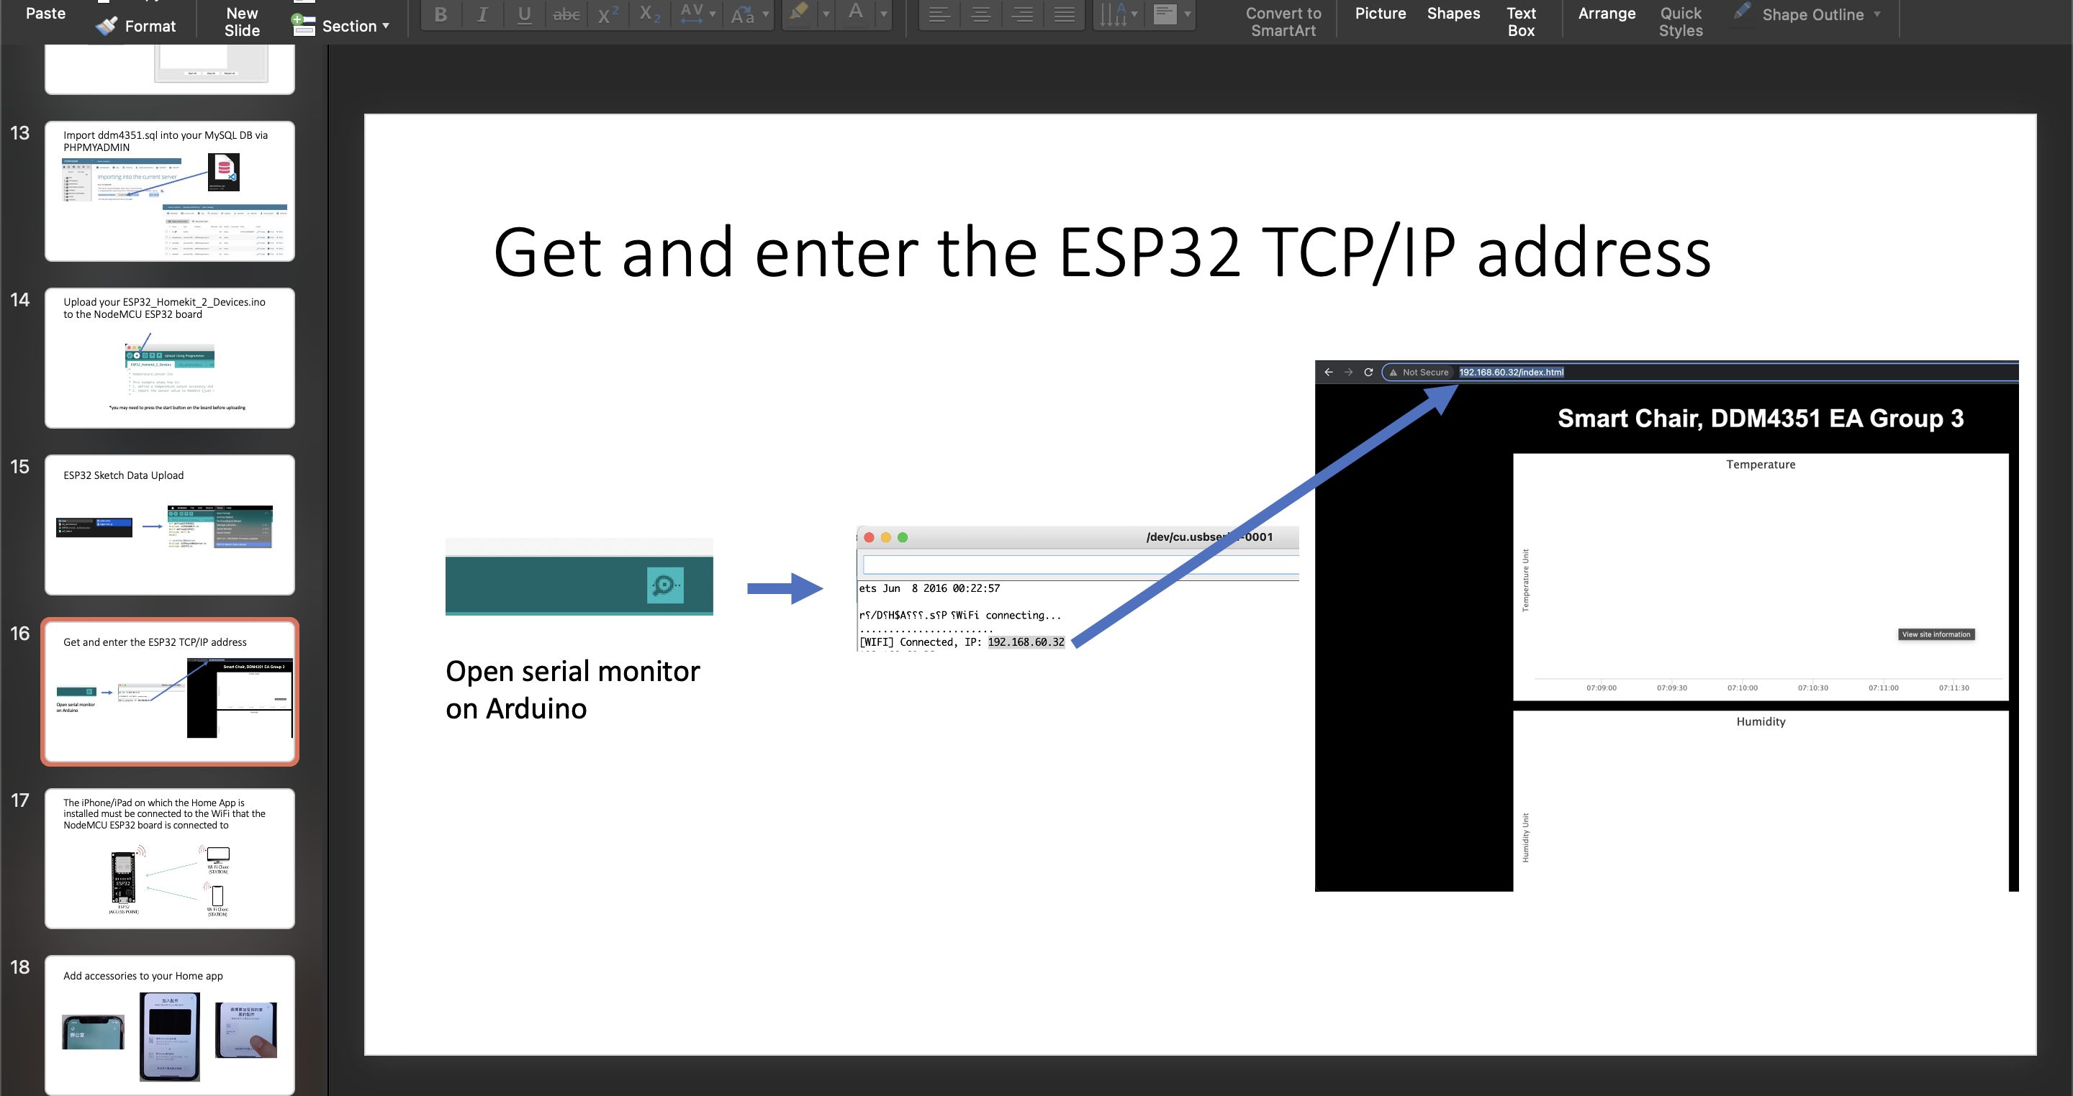
Evidence of my work produced for the project
04 Apps
Updated Installation Guide

Slide 29
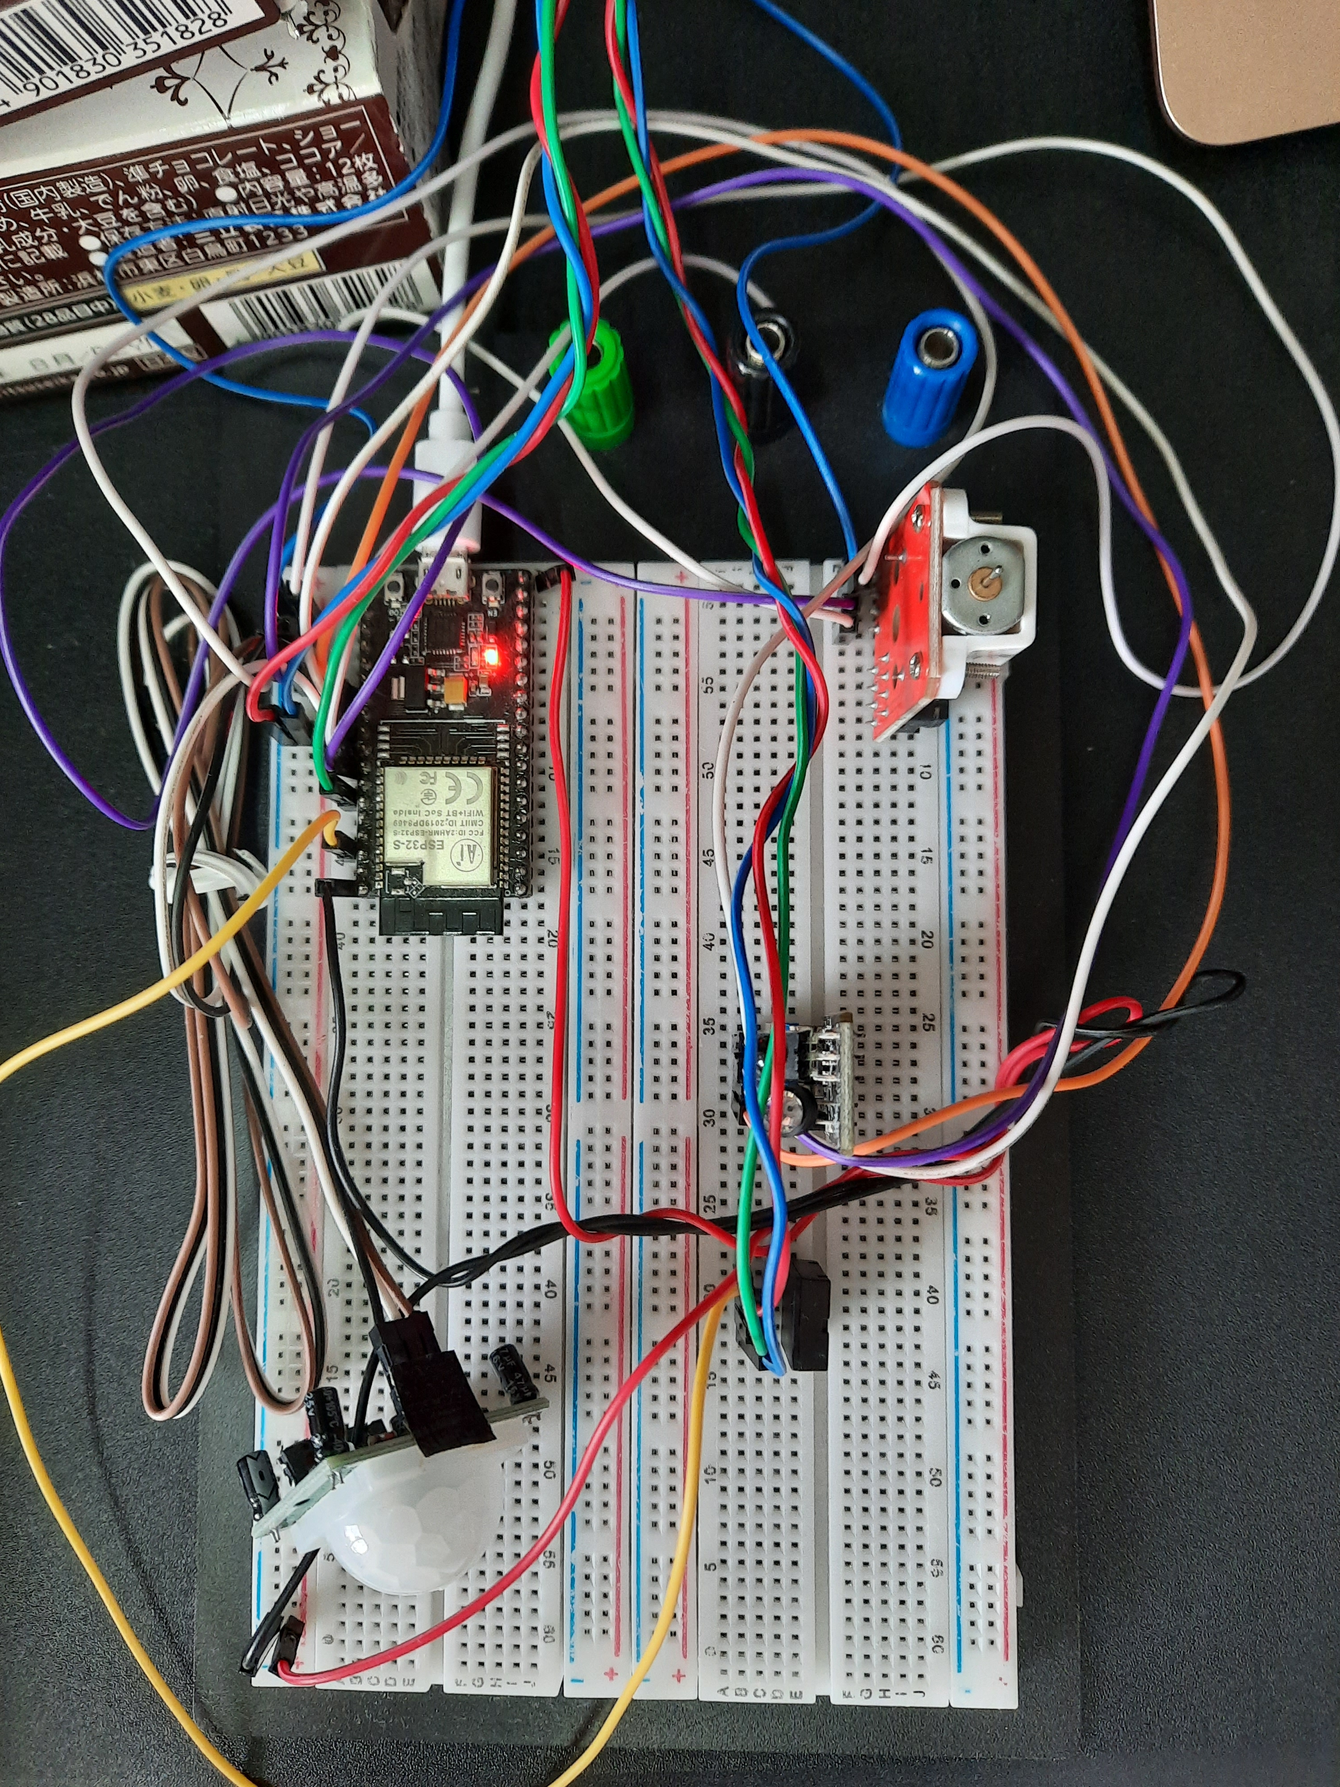
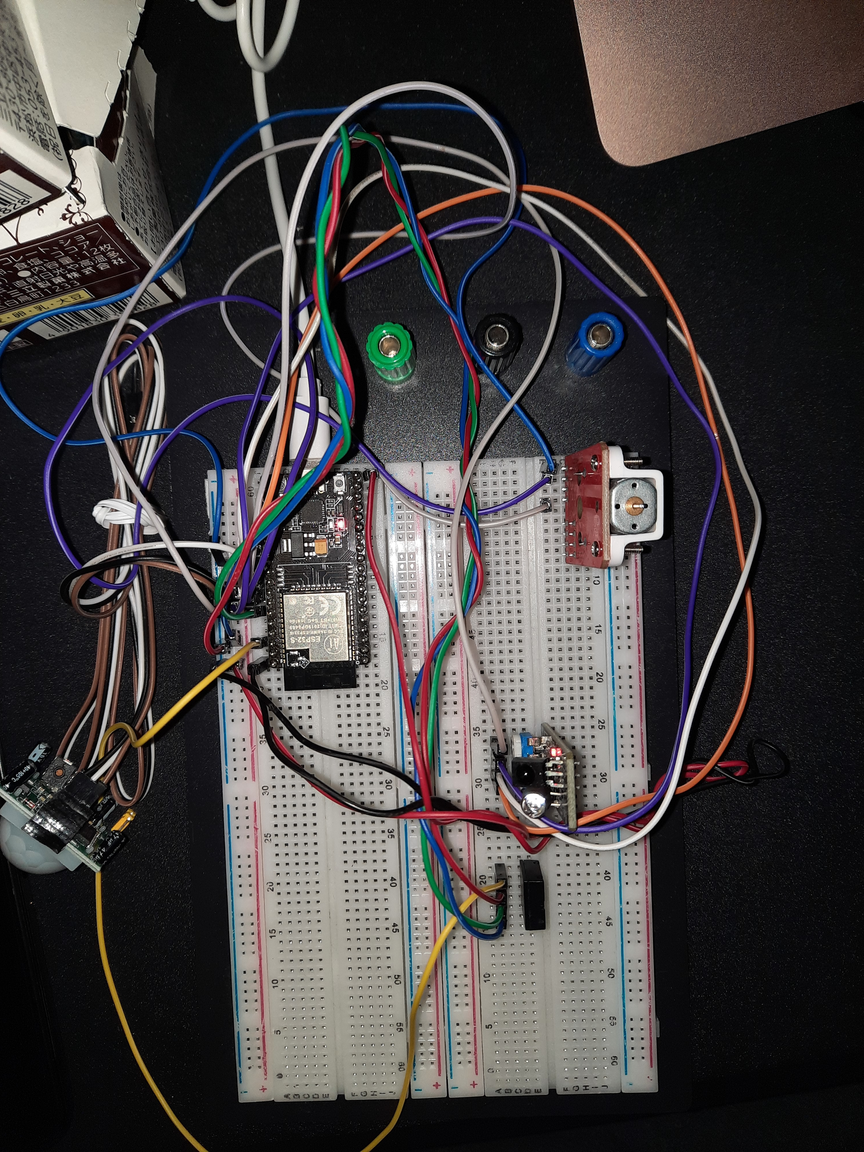
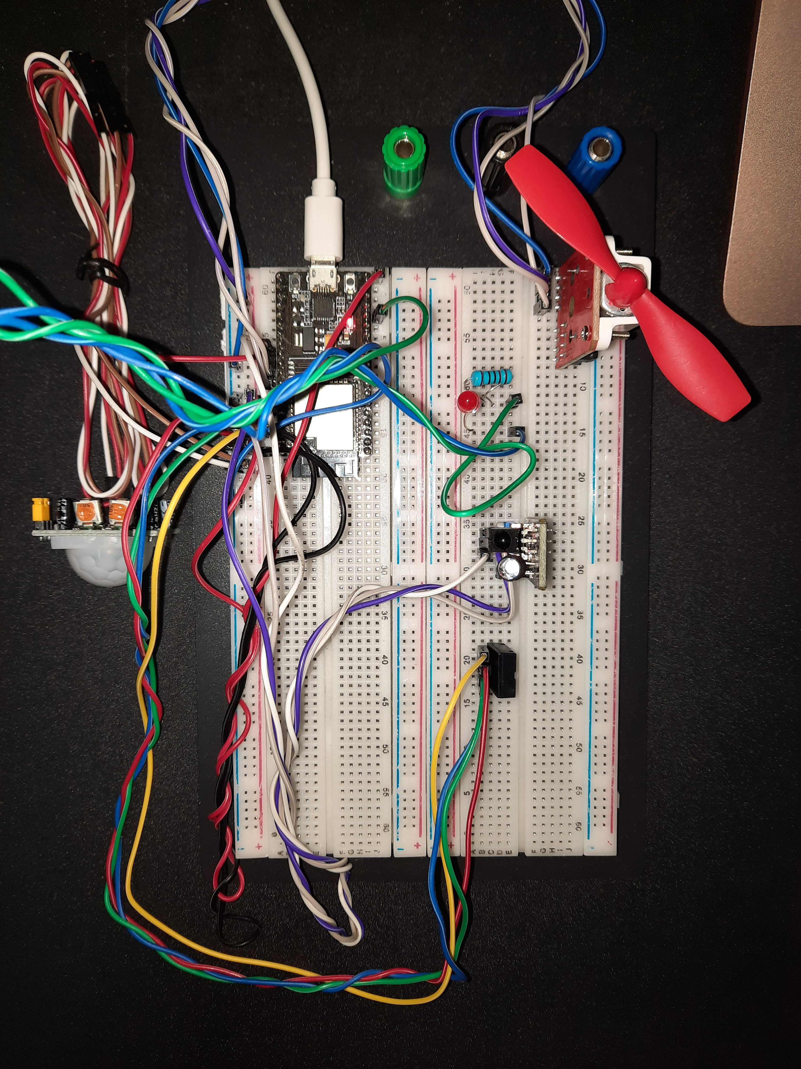
Evidence of my work produced for the project
06 Circuits
I created a circuit for this project because a second test is required

Slide 30
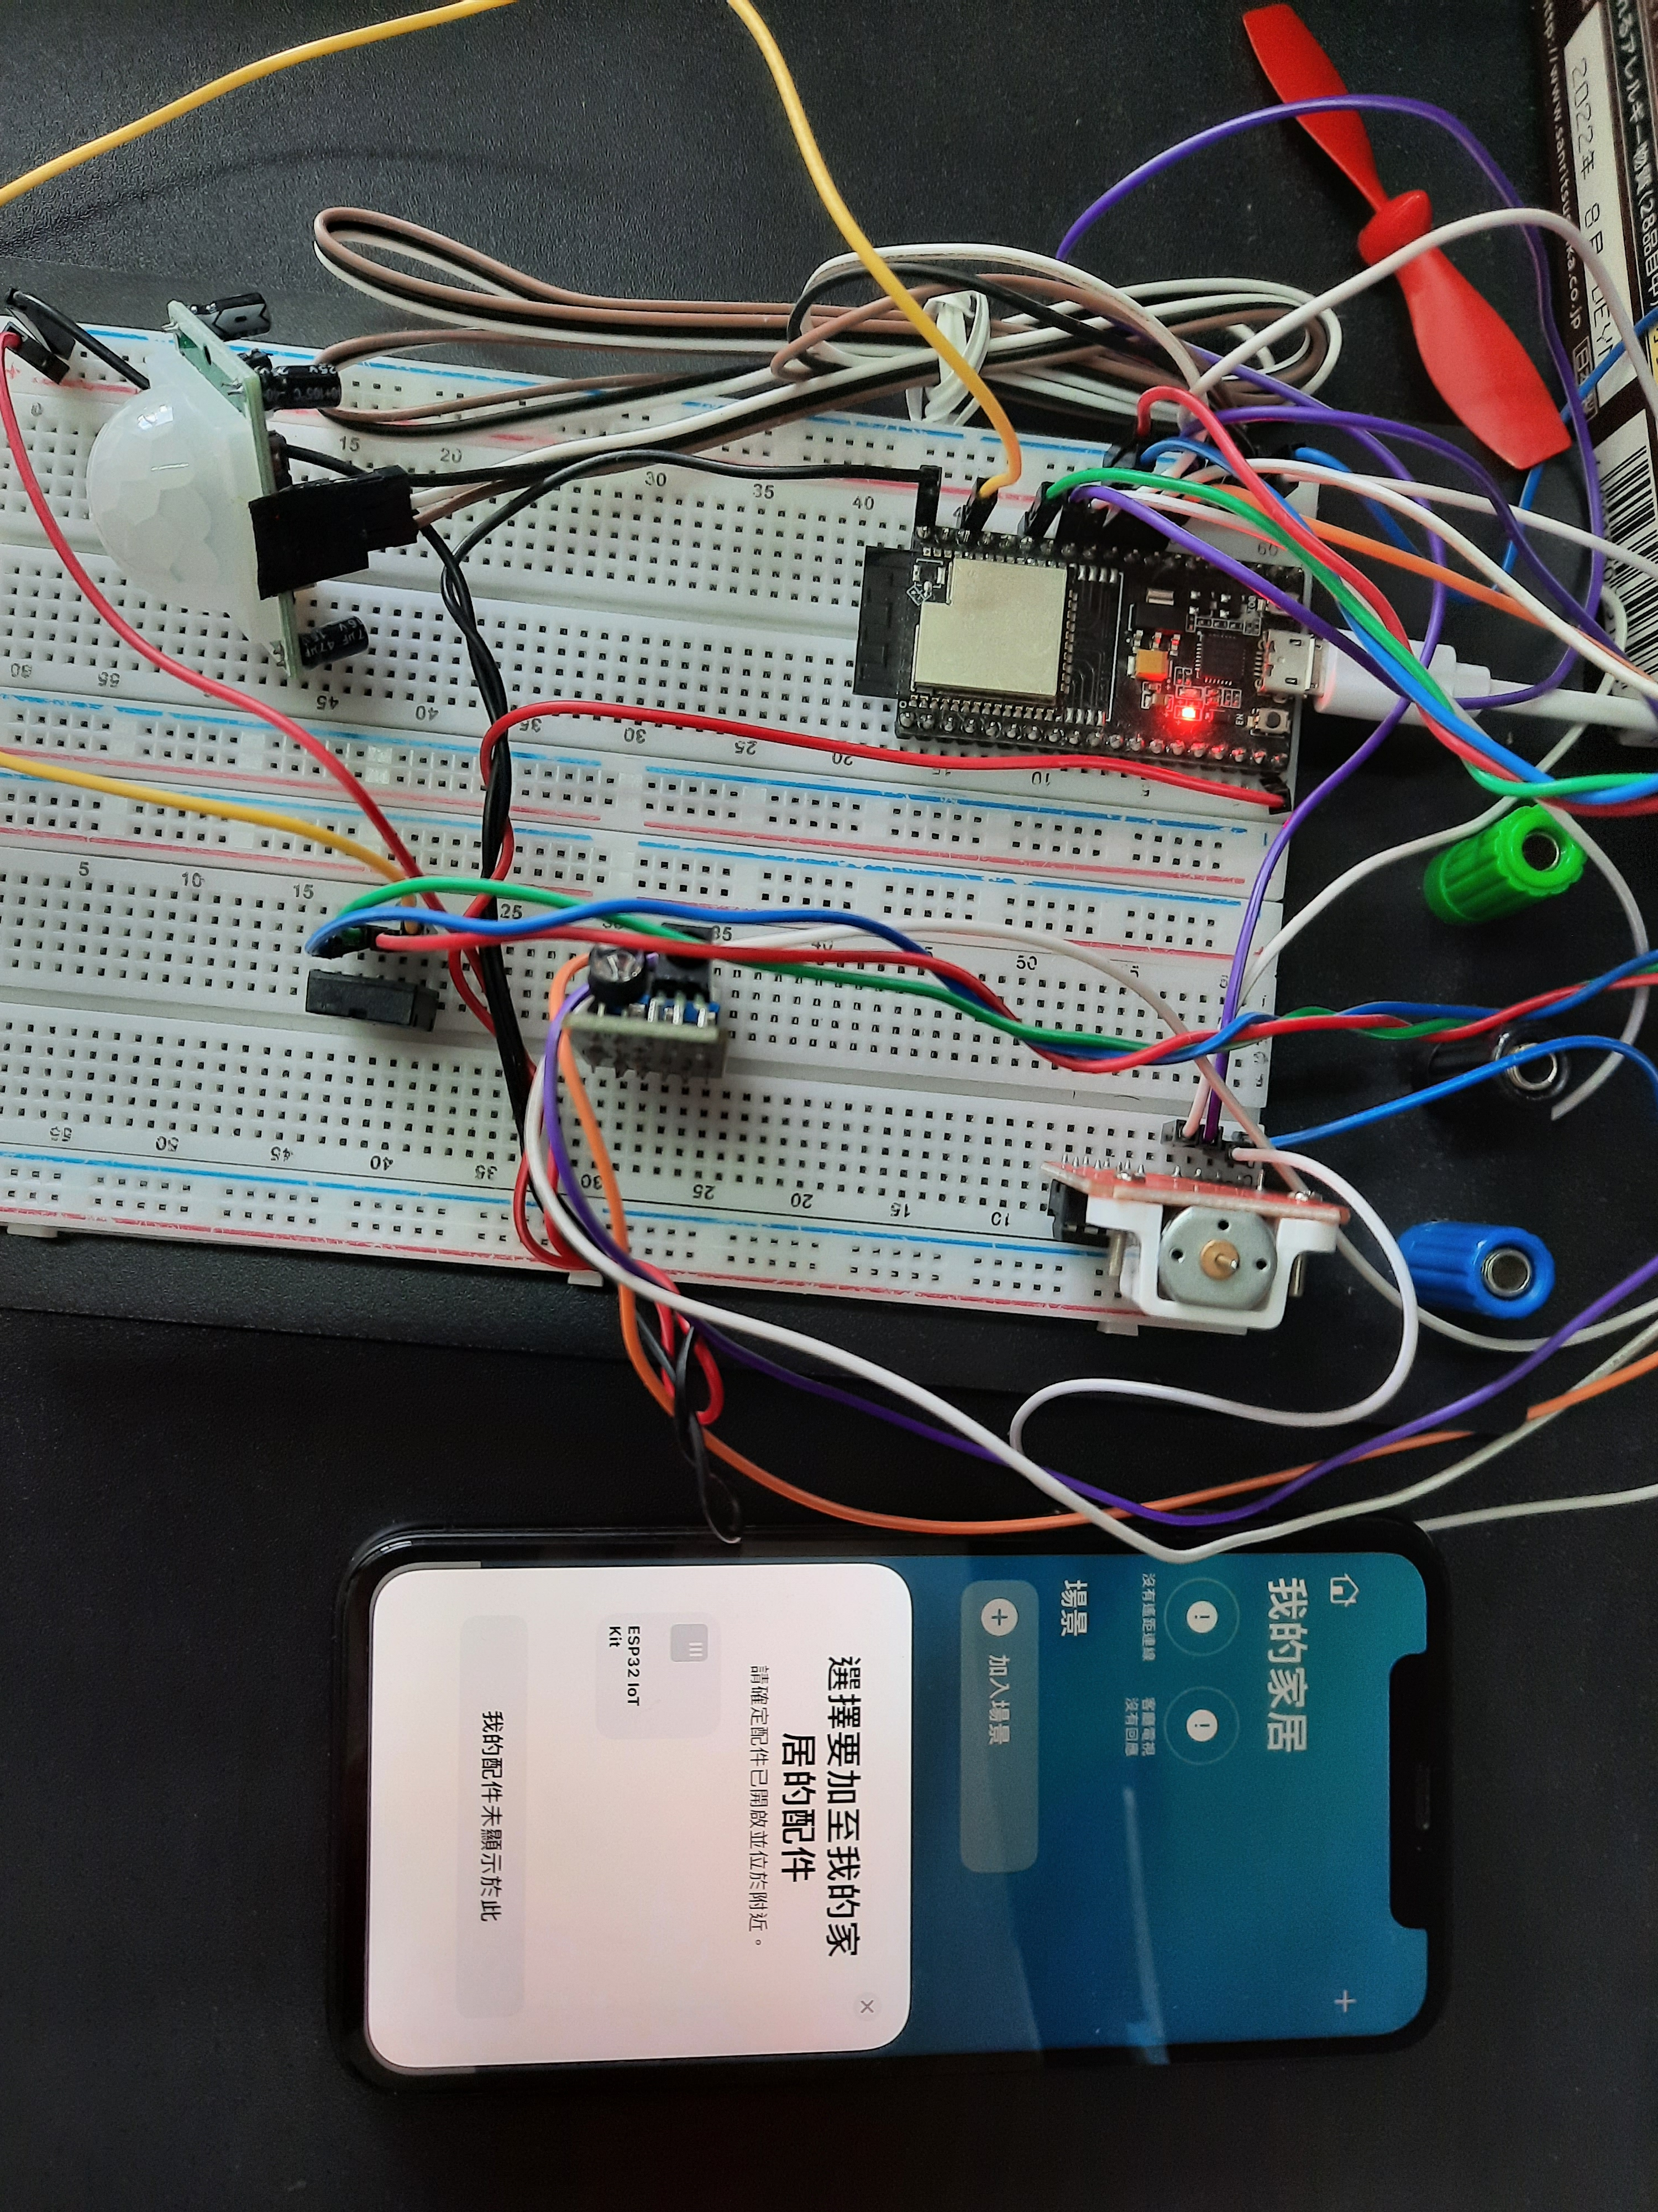
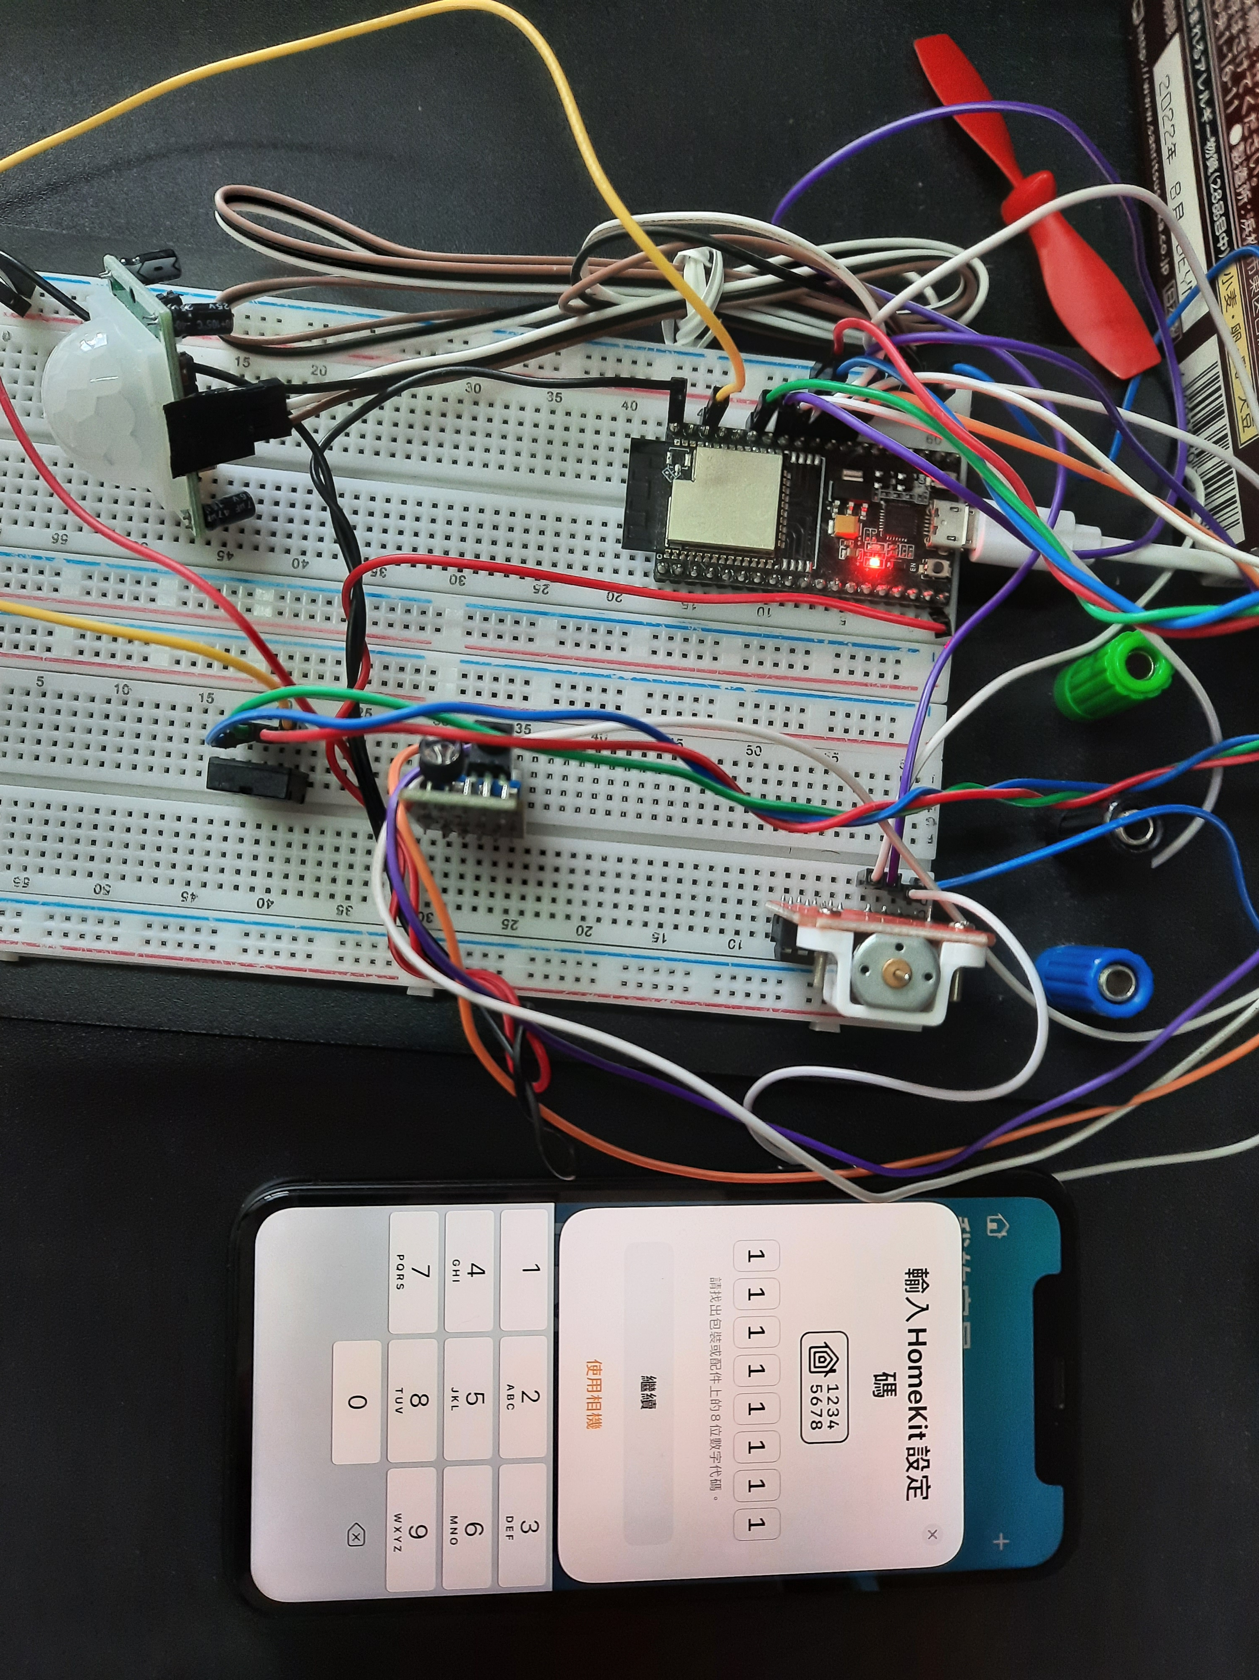
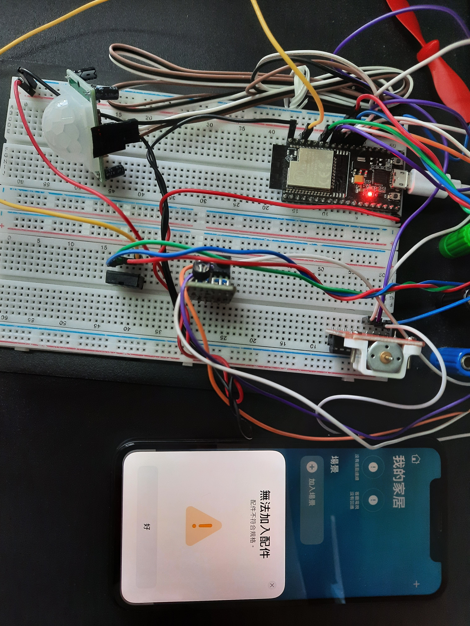
Evidence of my work produced for the project
07 Testing

Slide 31
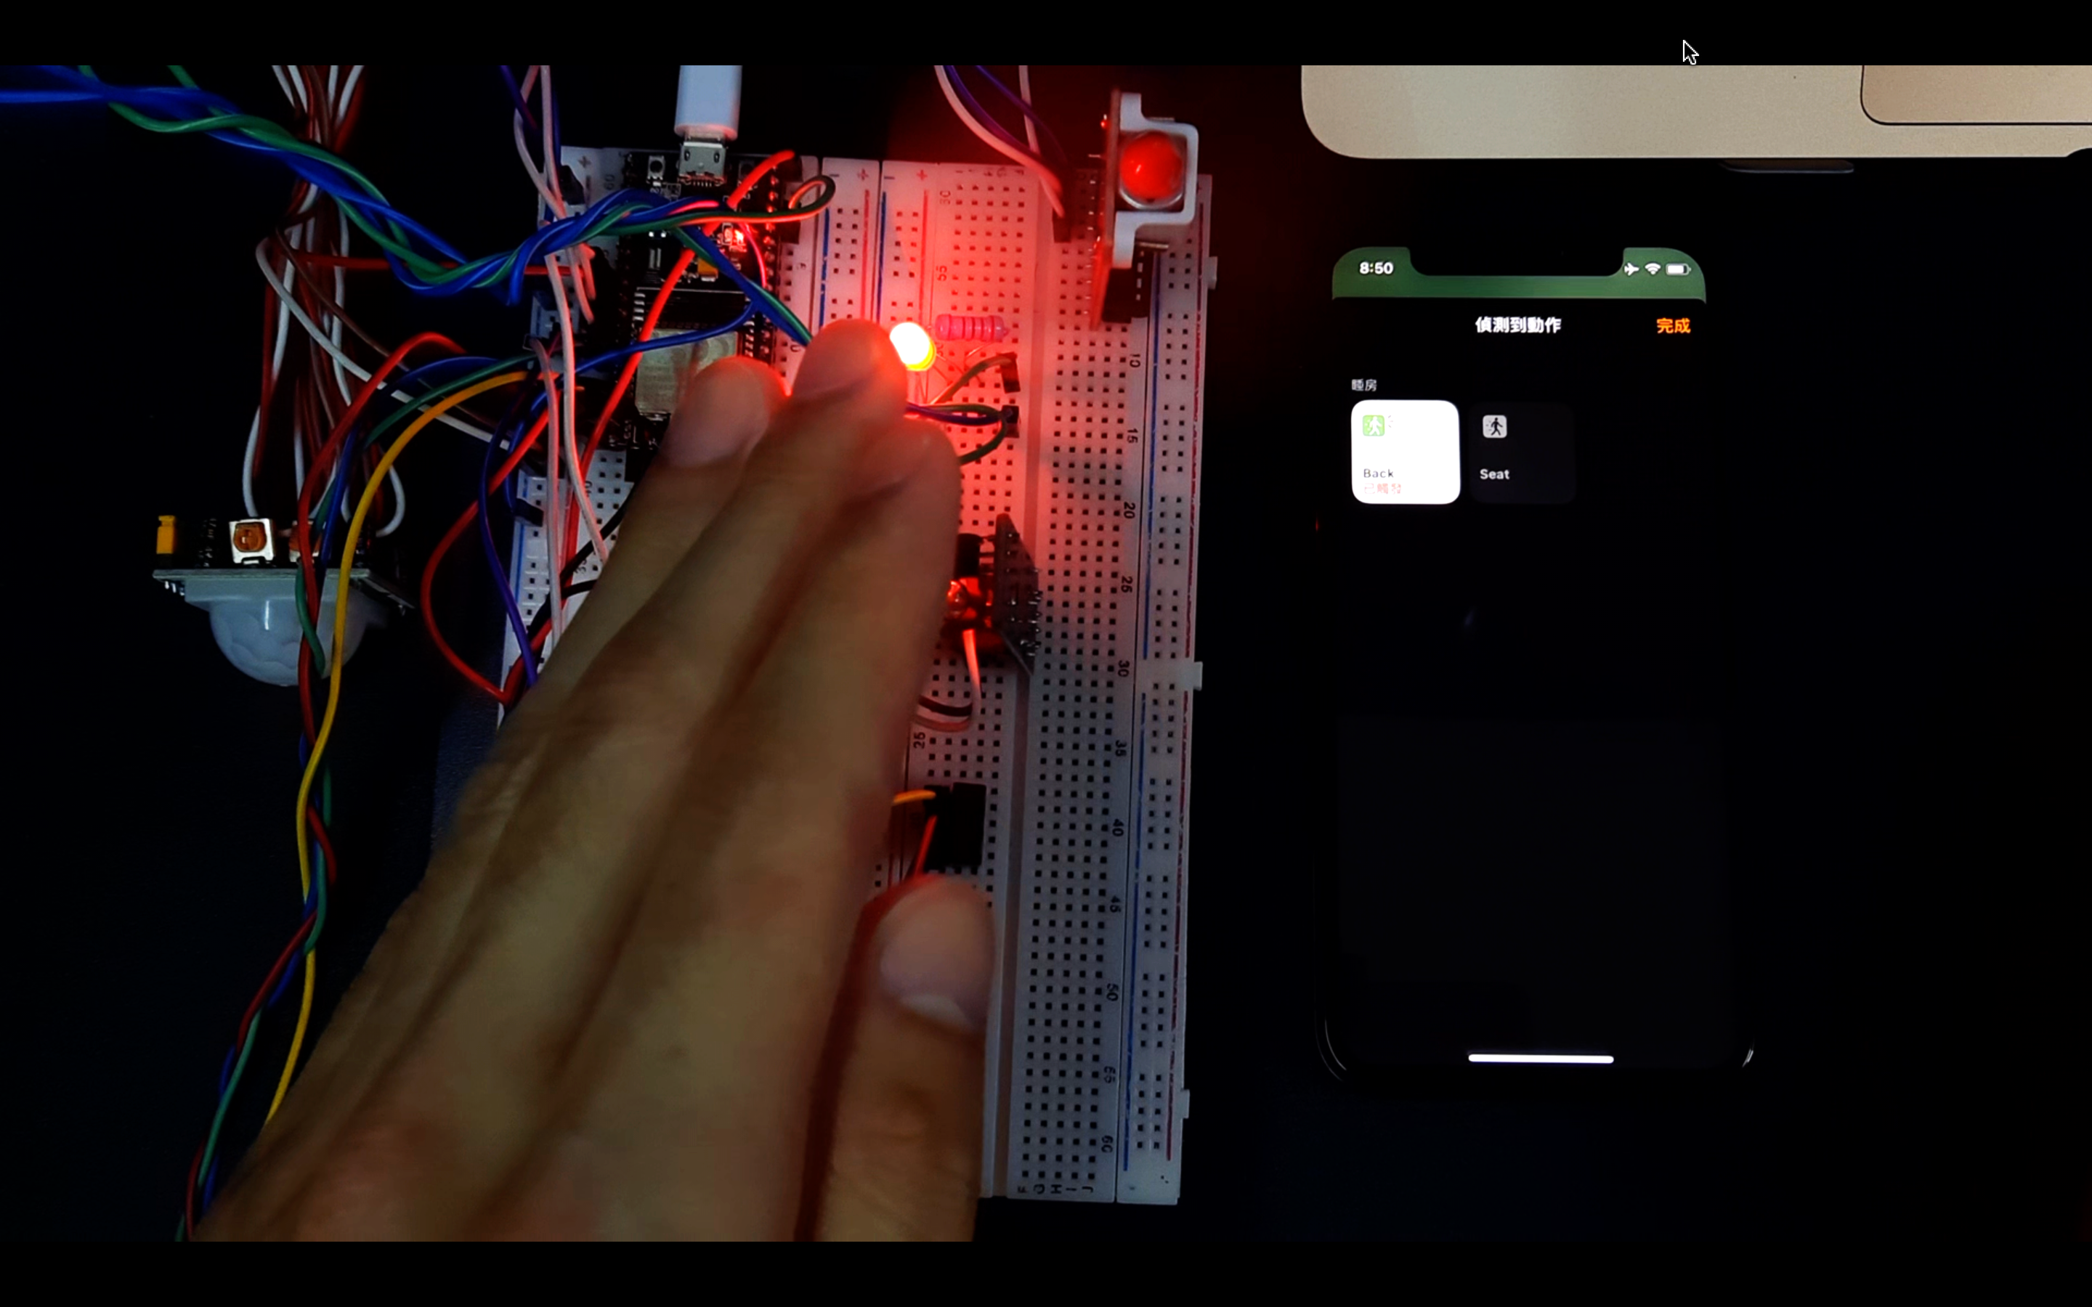
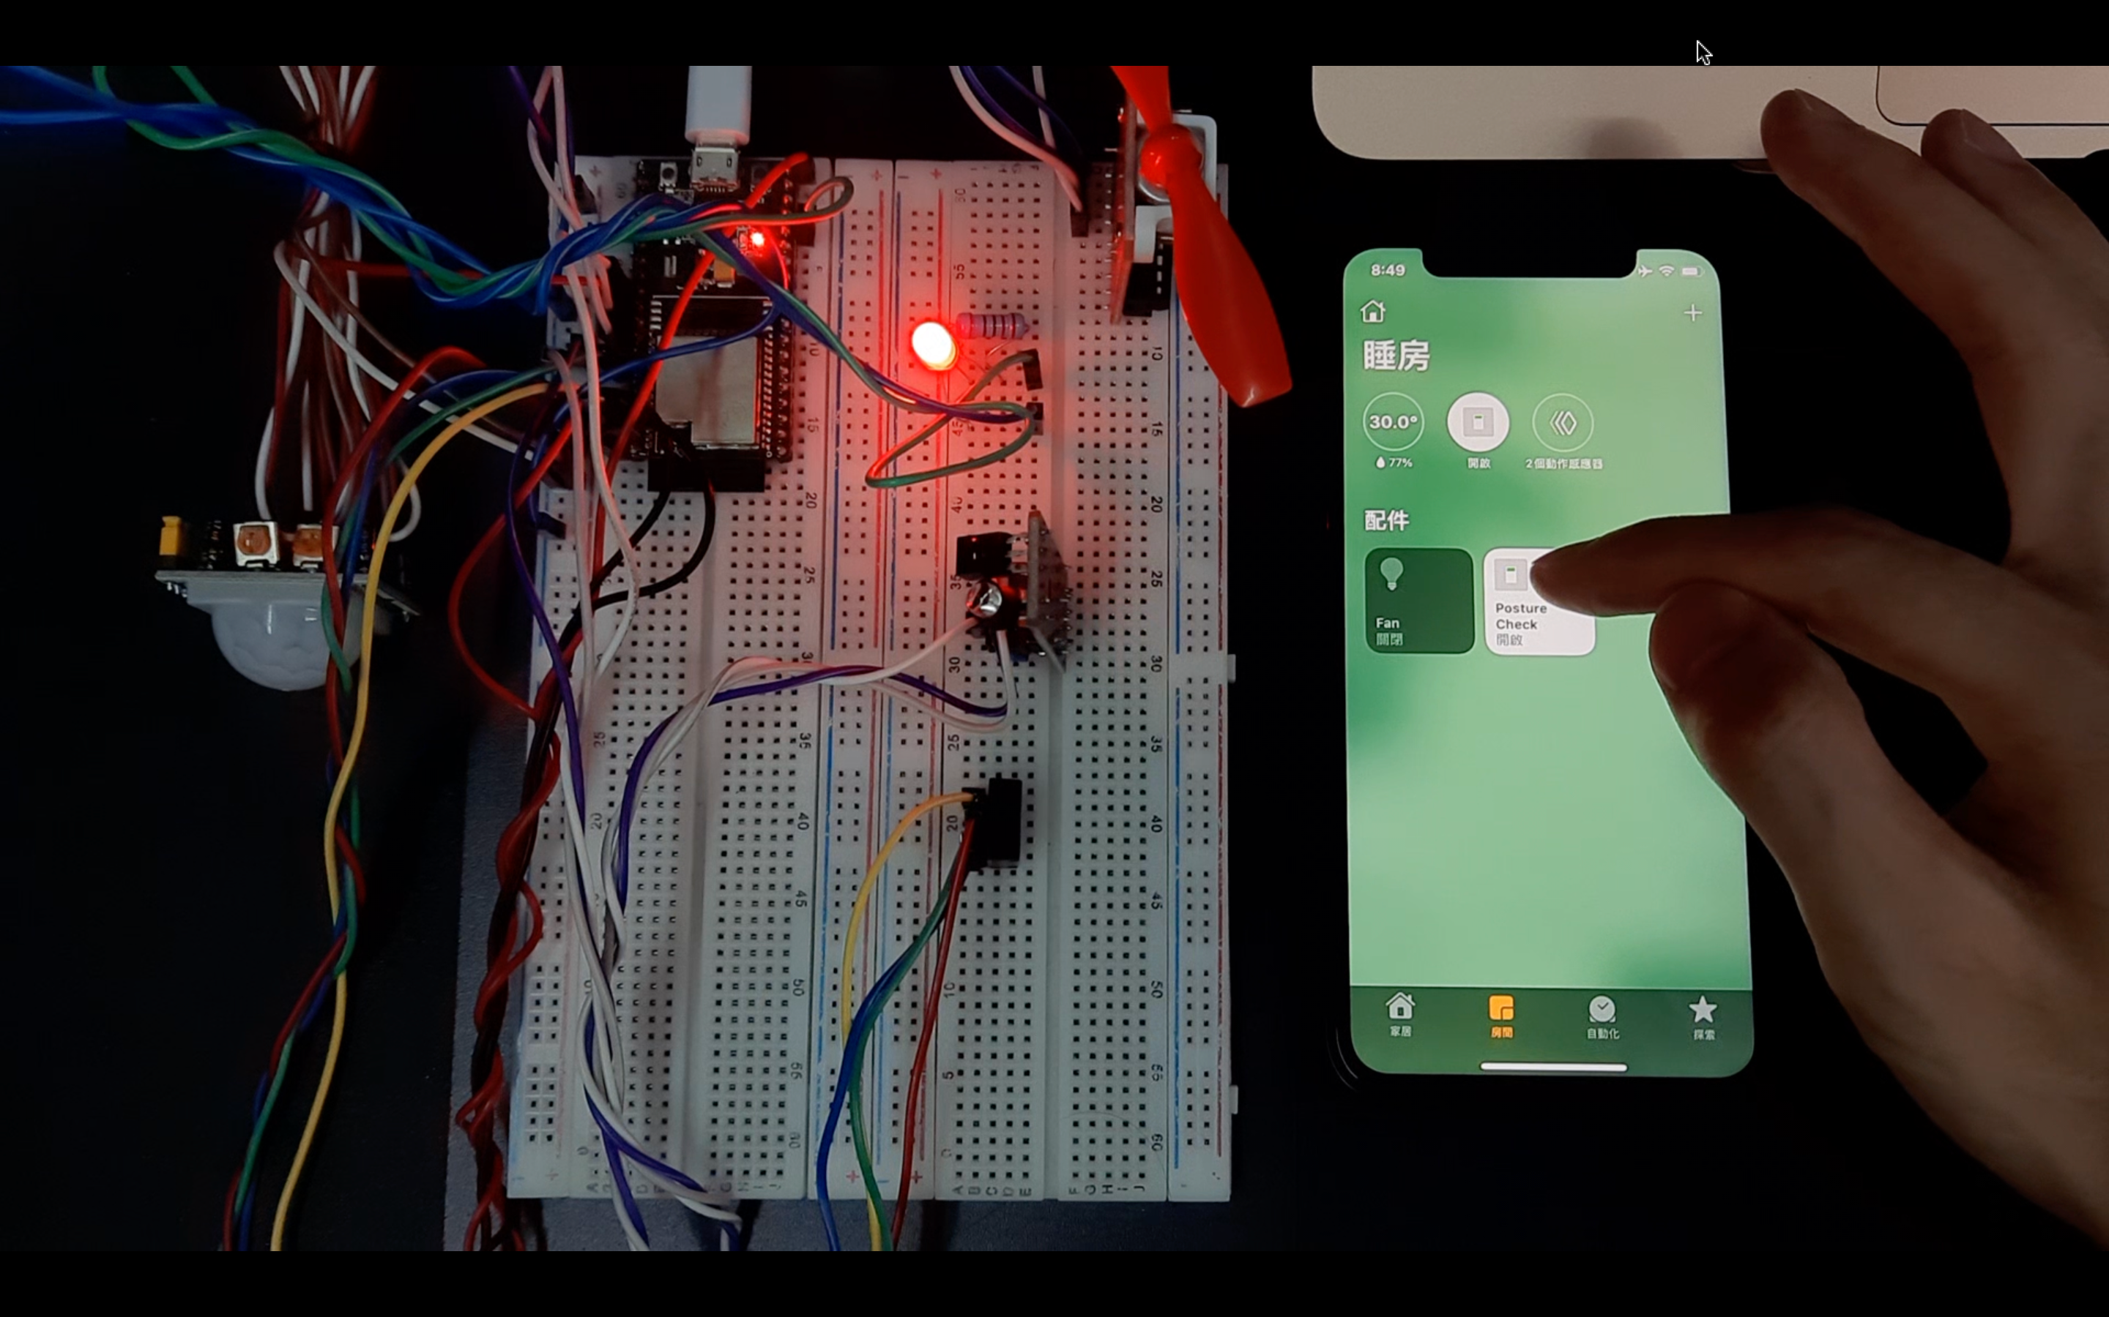
Evidence of my work produced for the project
07 Testing
Prototype able to run after lecturer diagnosis

Slide 32
Personal Review and Evaluation of the project outcomes and group members
Personal Review:
As the leader of the entire project, I can understand that project management is not an easy task, especially when the time is tight. Fortunately, however, our lecturers were very good, giving us the opportunity to refine the application in more detail with numerous attempts. As a result, we achieve highly seamless teamwork and functionally successful prototypes of smart living projects. Although the Scrum project management is often not implemented and tasks are not completed on time. In fact, if we had more time on this project, there will be implemented ML advice and analysis, and more features.

Slide 33
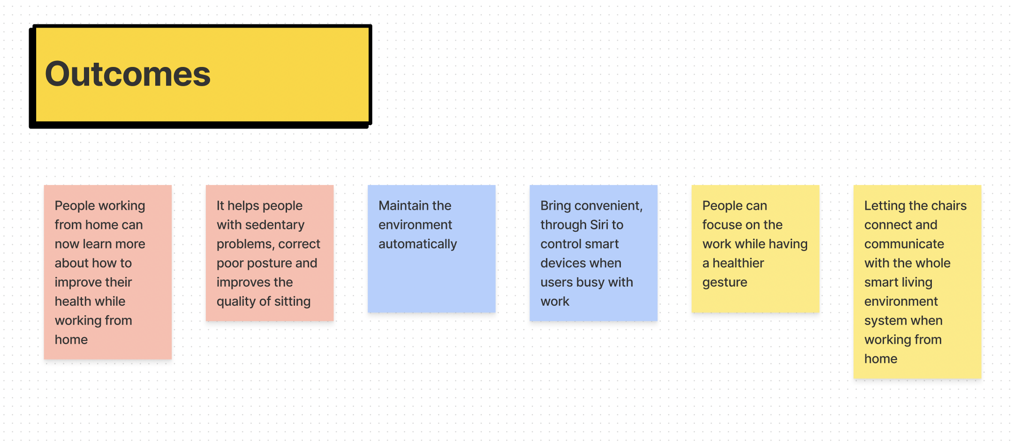
Evaluation of the project outcomes:
This project helps office workers, especially those working from home, now be able to learn more about how to improve their health while working at home. It helps people with sedentary problems, correct poor posture and improves the quality of sitting through the statistics and real-time data displayed on different user interface such as Home app on iOS, real-time chart on Web and historical data on MySQL Database.

Slide 34
Fortunately, Ivan Cheung helps me as he was the first and relatively fast responder. He is a very good helper. He always help me to tackle the issues of different parts. With his help I can always complete our work faster than I expected.
CHEUNG Ka Hei, Ivan – 8/10
Victor Yue helps me as he was a helpful and relatively positive teammate. He makes our communication better, listing out the point of our brainstorming and point out the problems we are facing. Helping the project to the right direction. As a result, we were able to complete our project in more detail than I expected.
YUE Pok Man, Victor – 6/10

Slide 35
Personal ideas on further improvements of the project
Dashboards on the web should provide filters and time periods. And we should use TensorFlow.js to implement the ML model for future sitting advice and sitting quality analysis. If we had enough time to do it, we could make an app to replace the Home app, allowing users to monitor their health through our optimizations and get useful health information more easily and personalized.

